Slide 1
Introduction to Computers, the Internet and Visual C#
Chapter 1 of Visual C# How to Program, 6/e

Slide 2
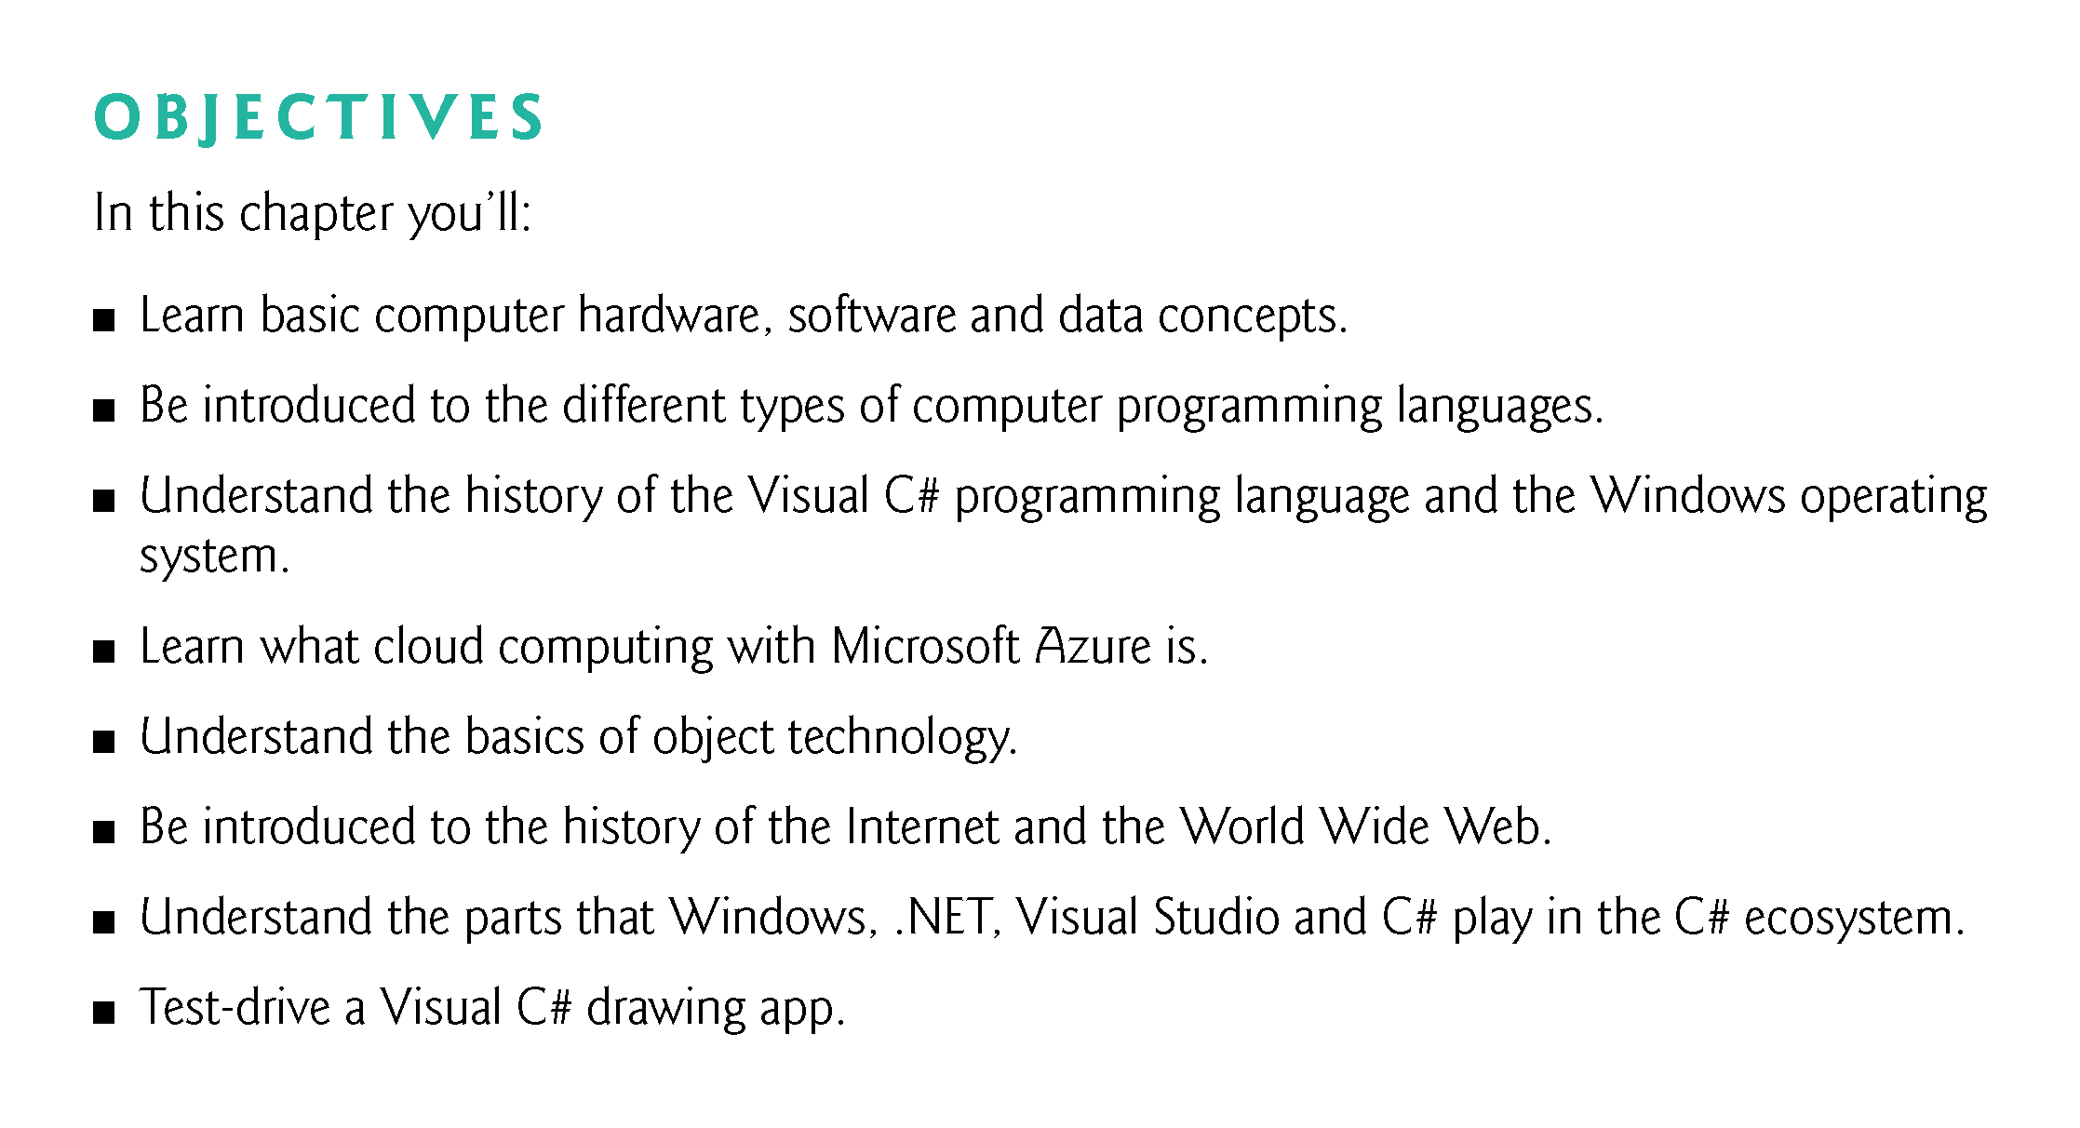

Slide 3
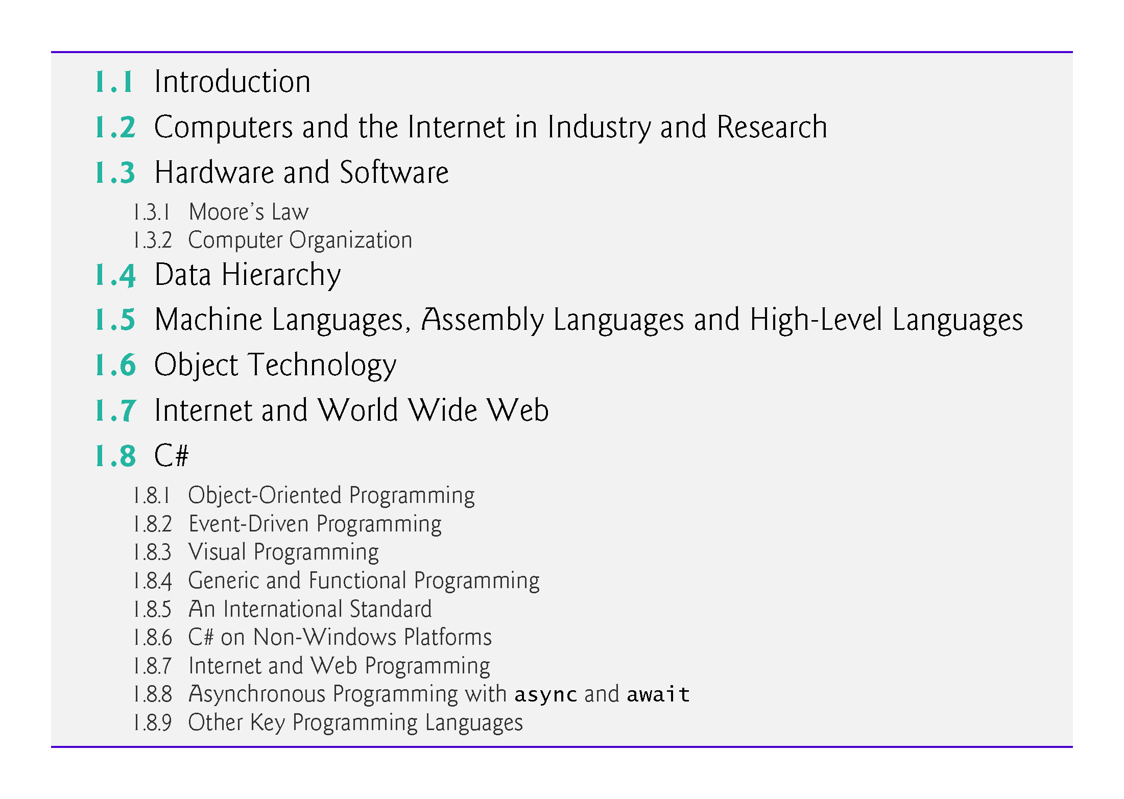

Slide 4
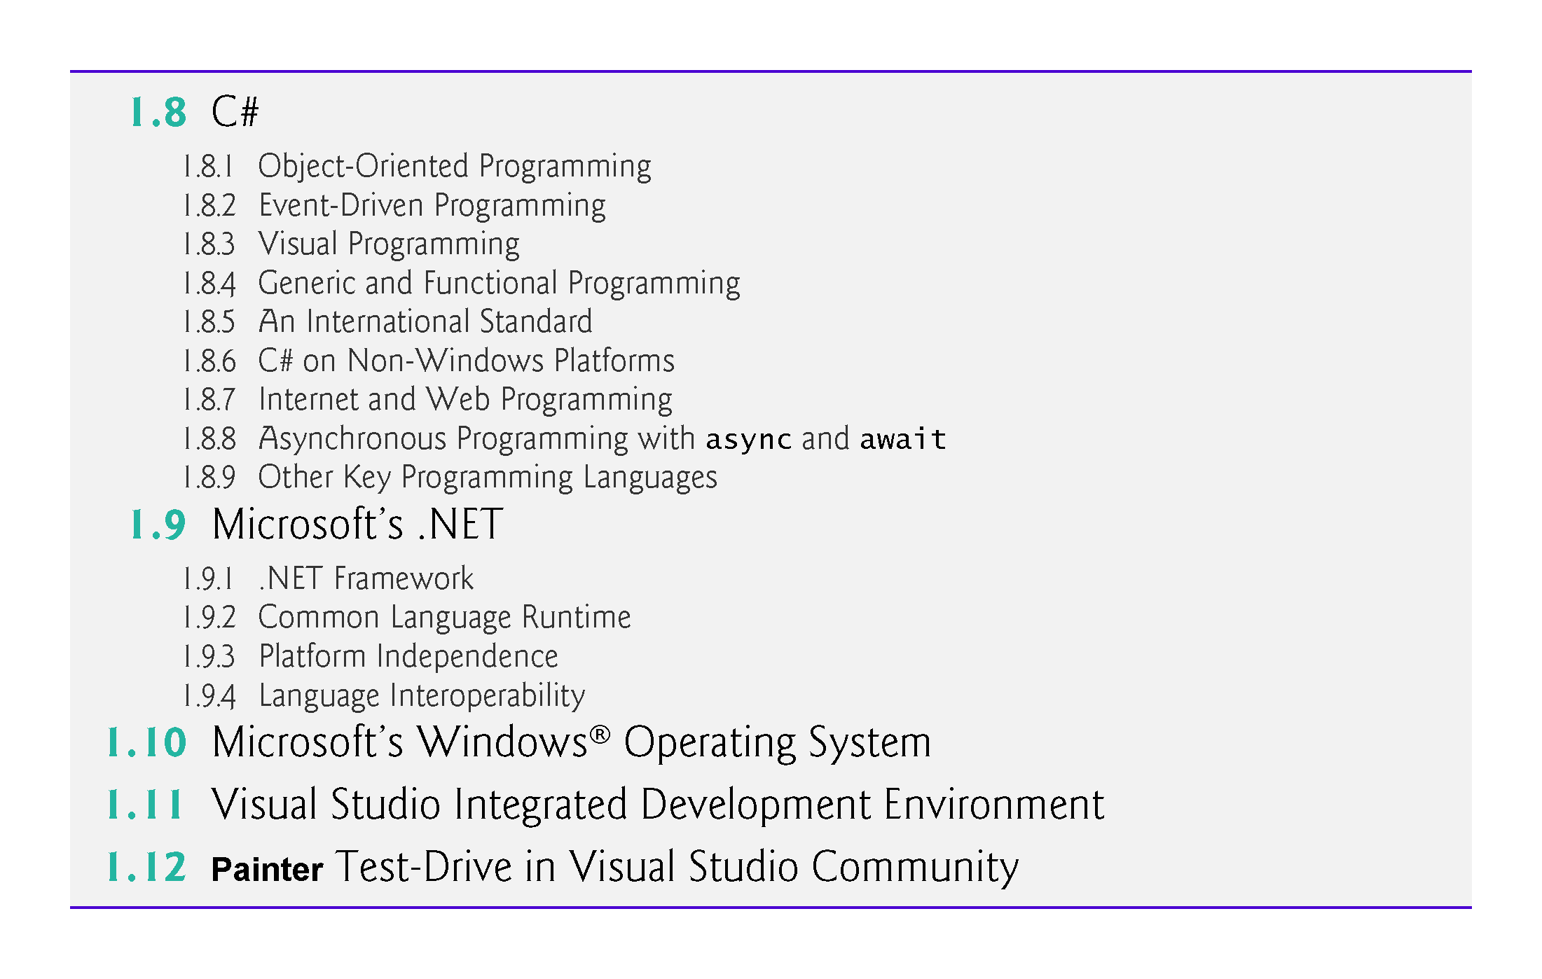

Slide 5
1.1 Introduction
There are billions of personal computers in use and an even larger number of mobile devices with computers at their core.
Since it was released in 2001, C# has been used primarily to build applications for personal computers and systems that support them.
The explosive growth of mobile phones, tablets and other devices also is creating significant opportunities for programming mobile apps.

Slide 6
1.2 Computers and the Internet in Industry and Research
Figure 1.1 provides a few examples of the ways in which computers are improving people’s lives in research, industry and society.

Slide 7
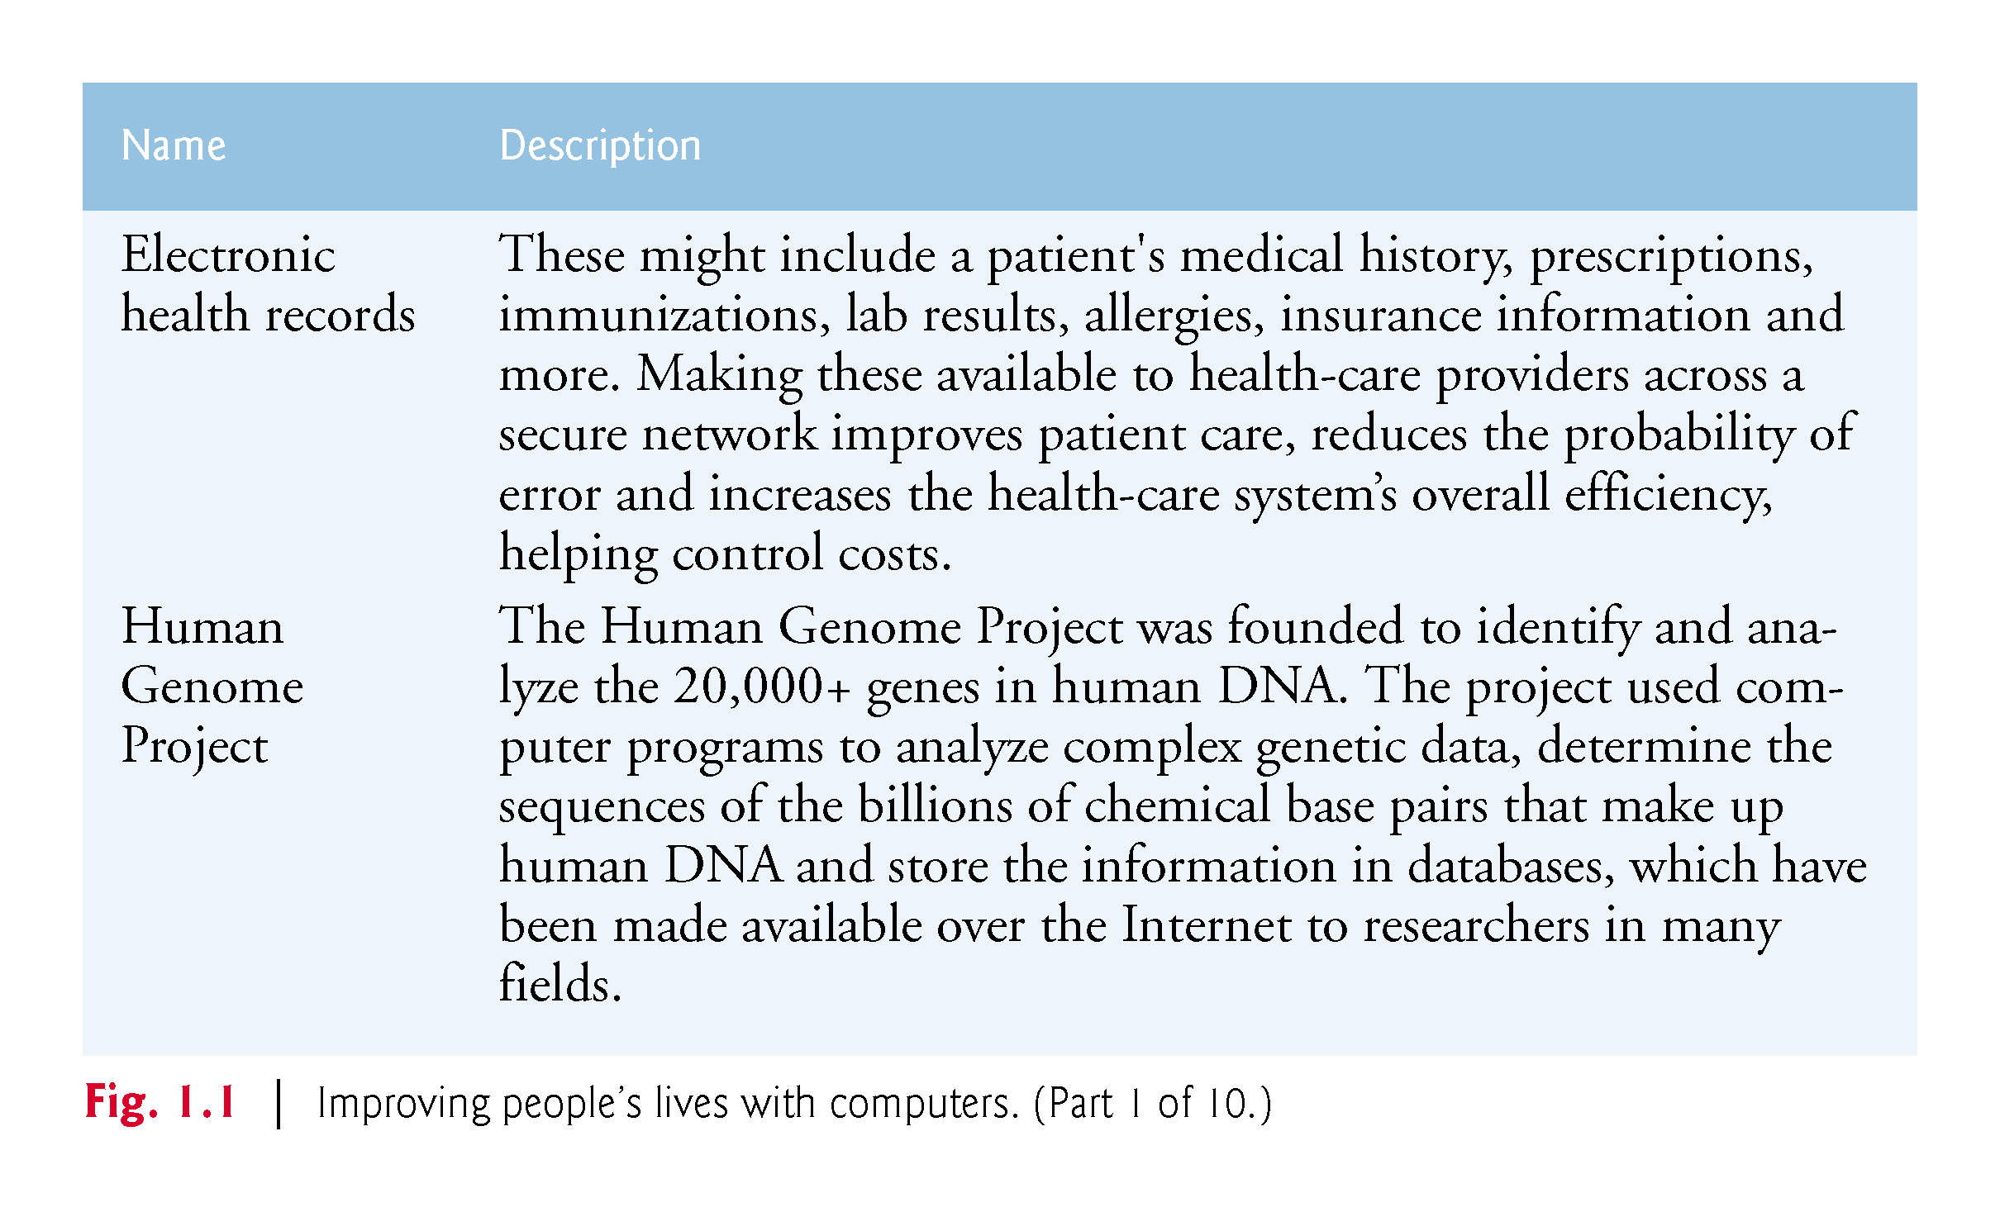

Slide 8
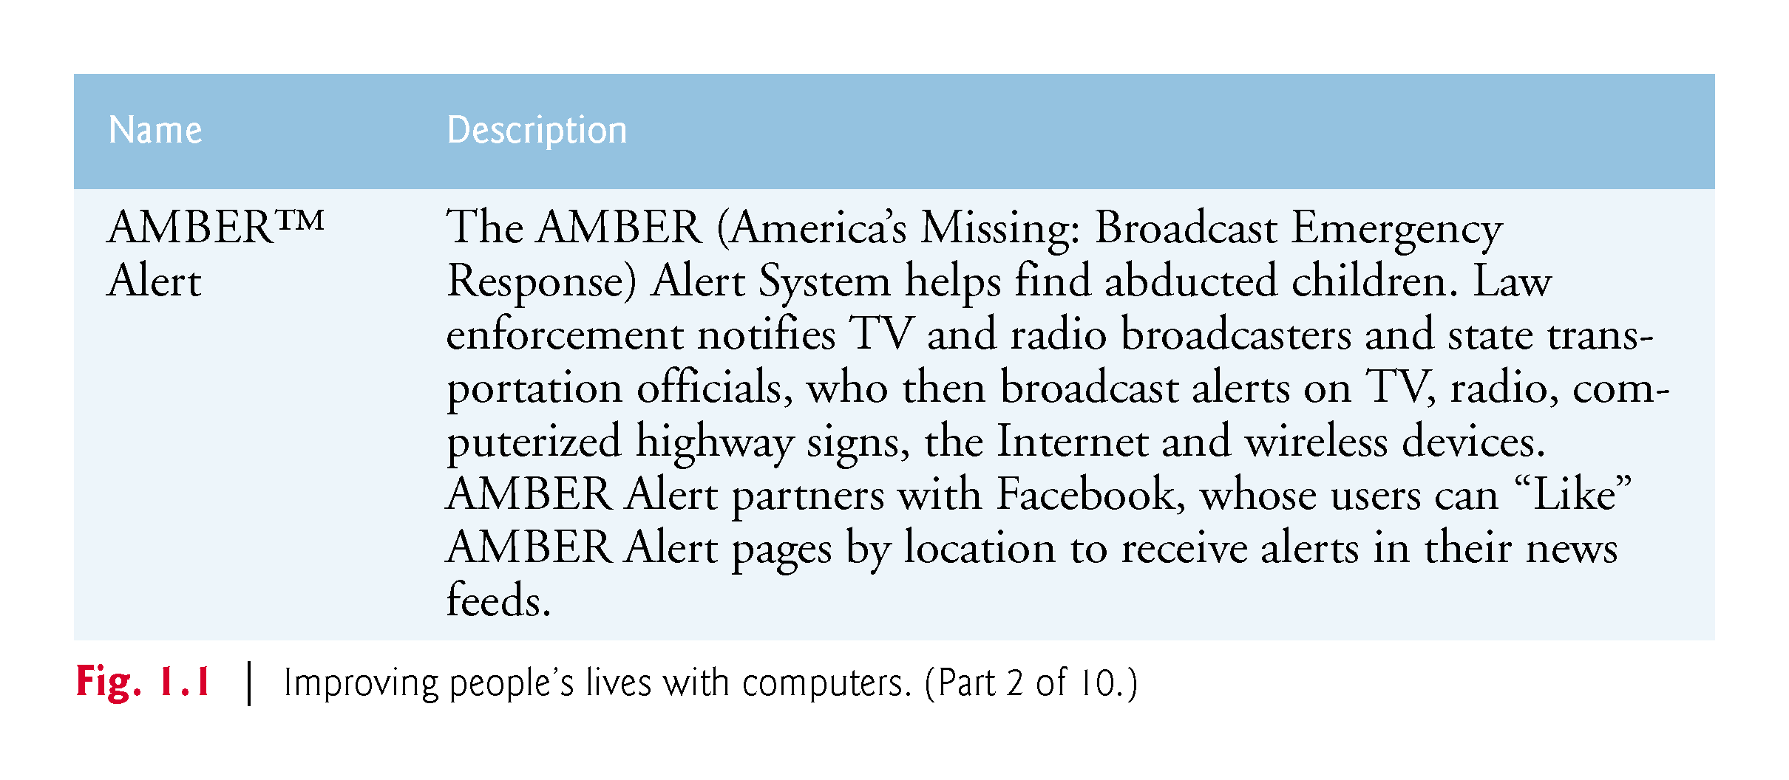

Slide 9
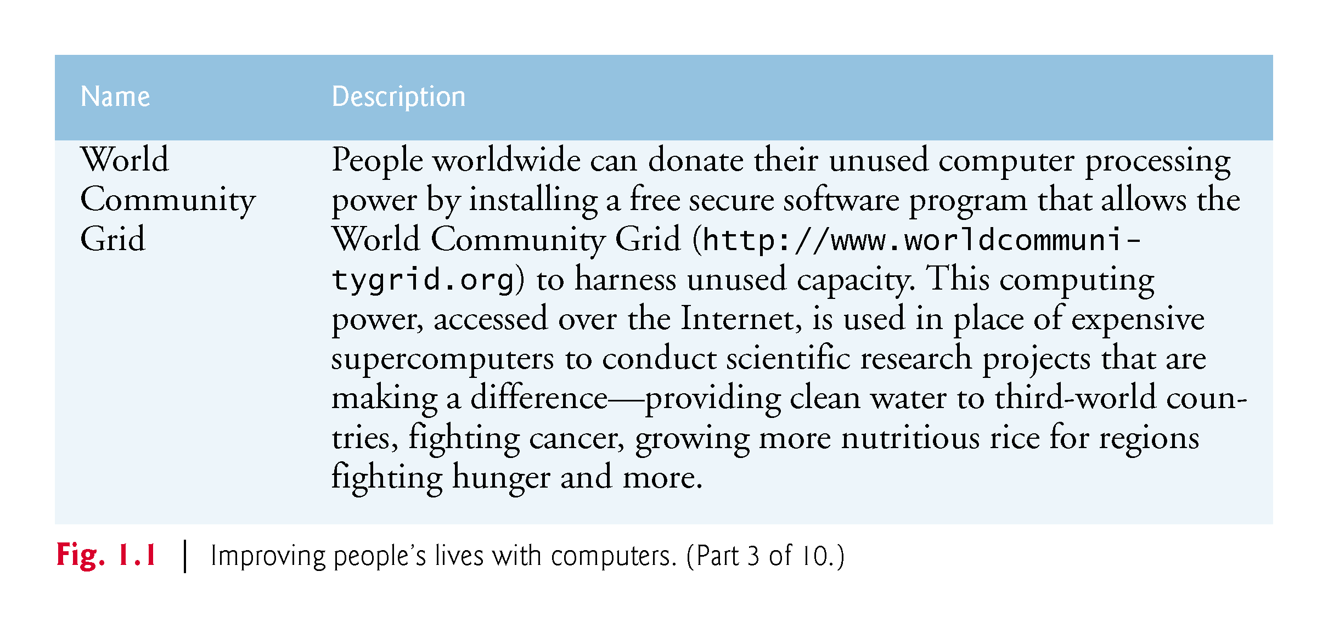

Slide 10
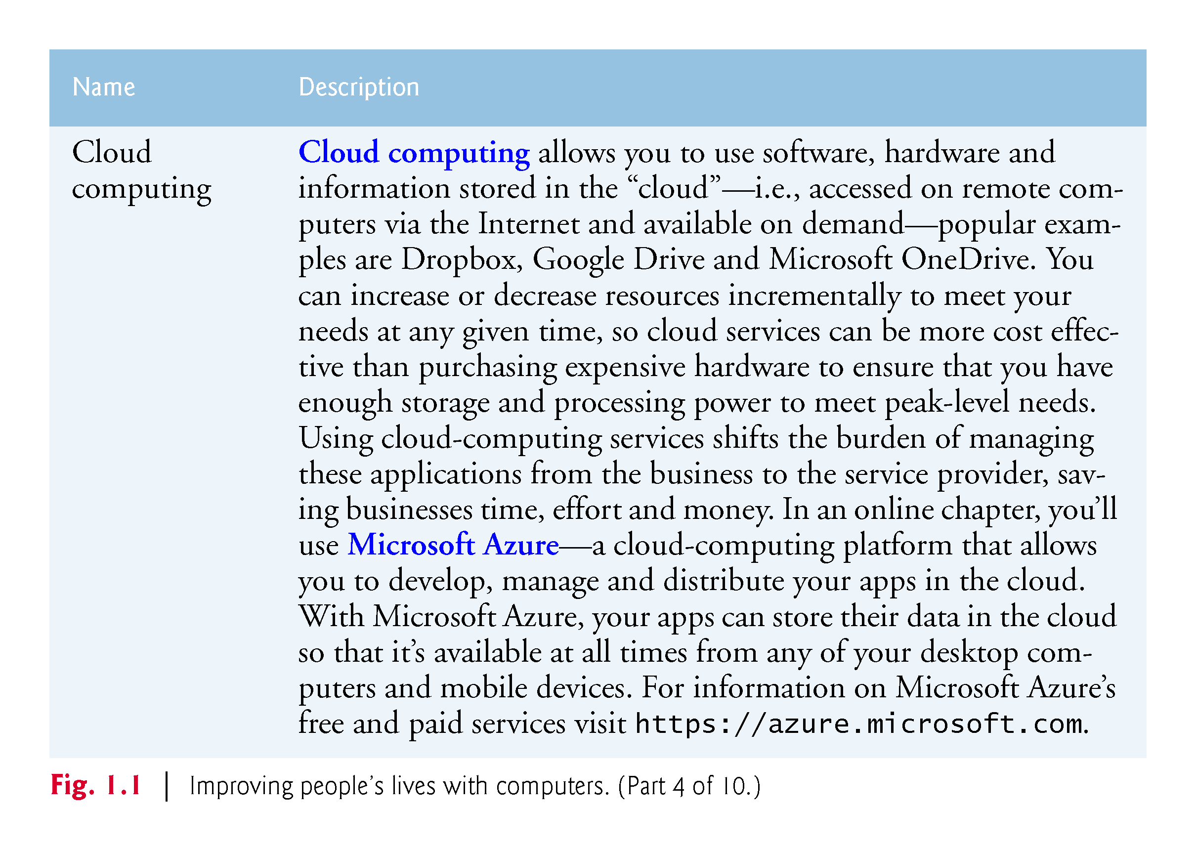

Slide 11
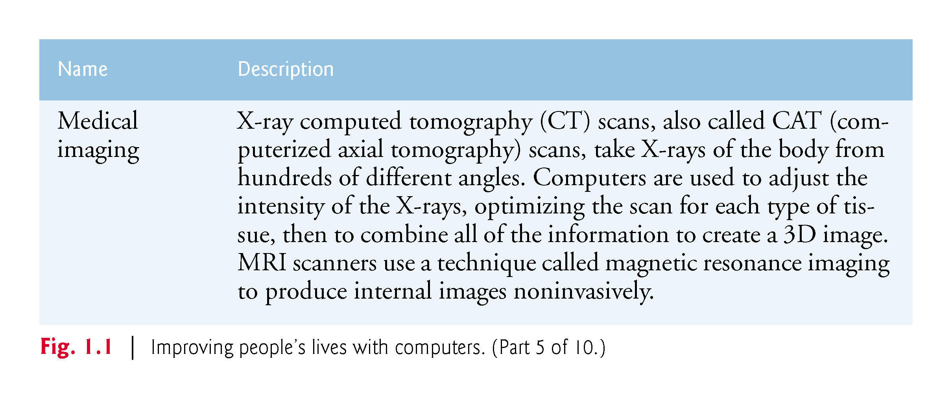

Slide 12
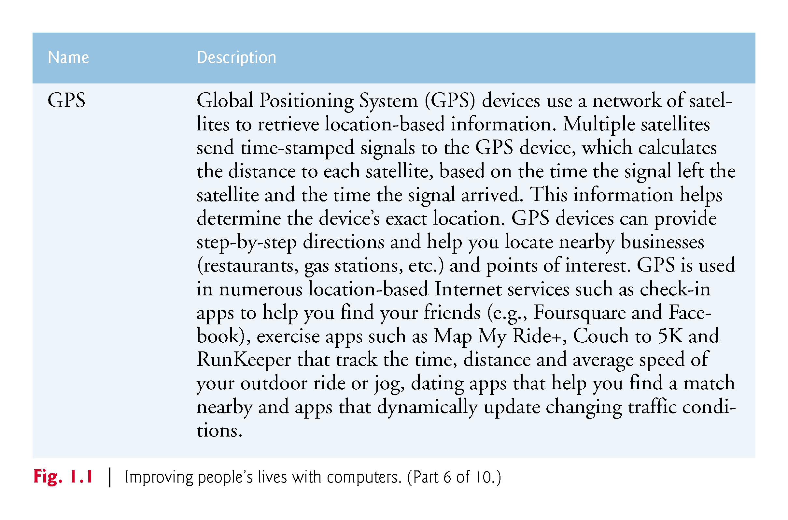

Slide 13
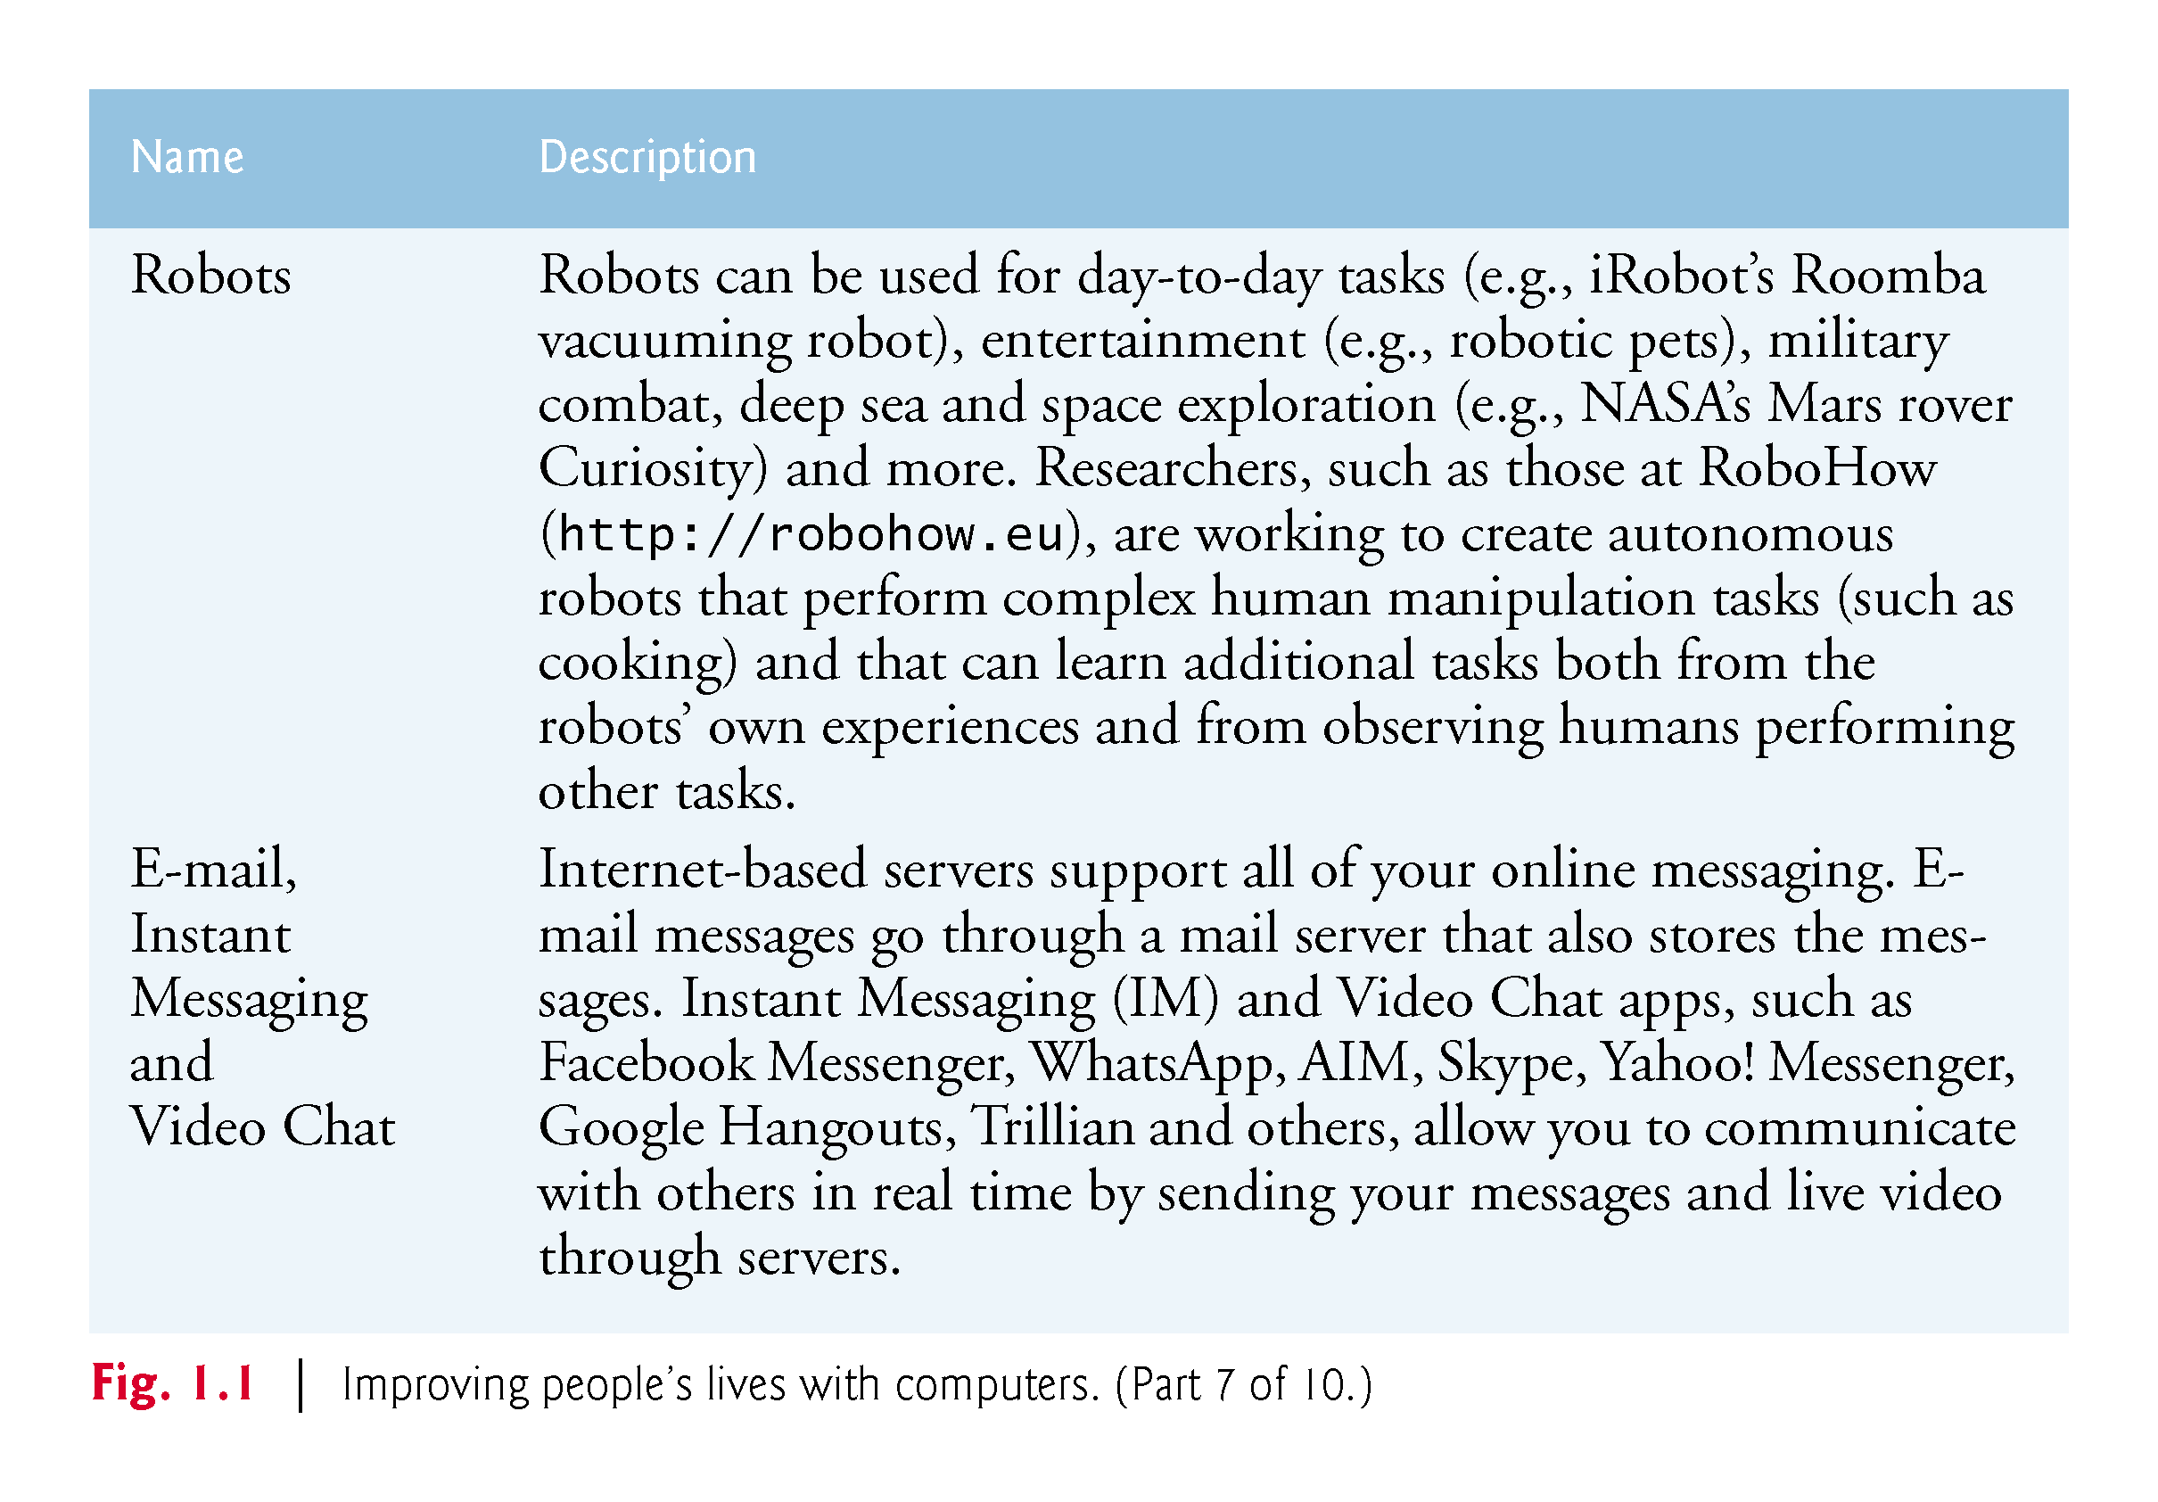

Slide 14
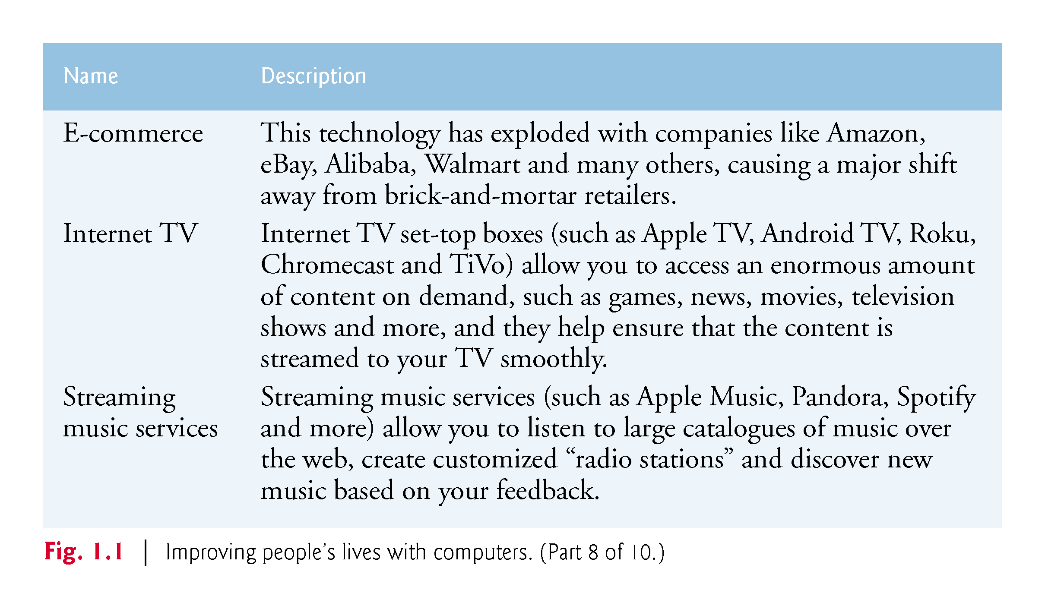

Slide 15
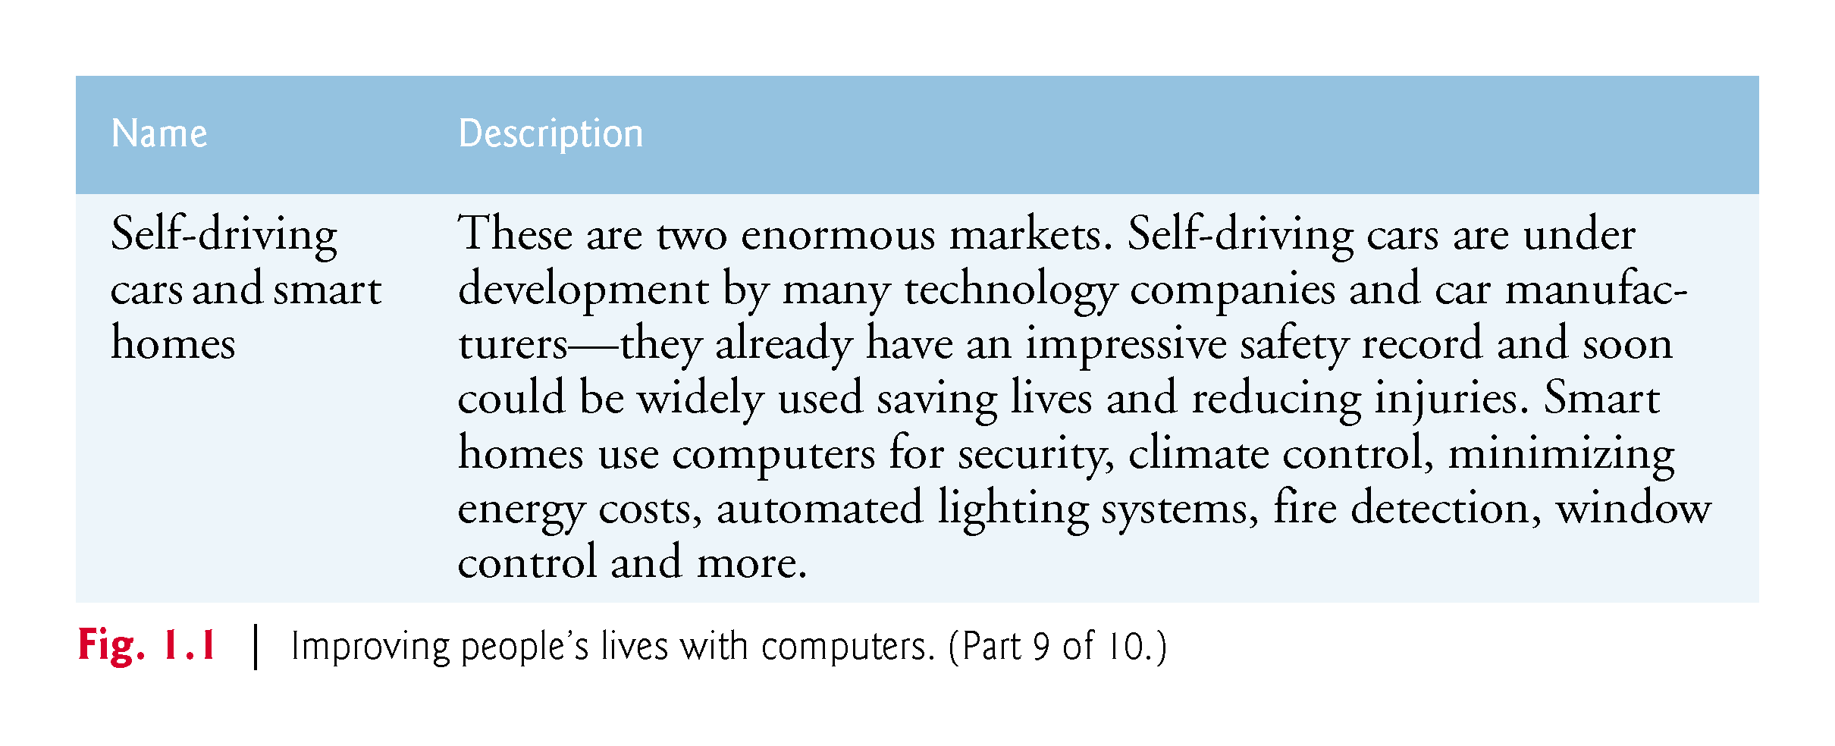

Slide 16
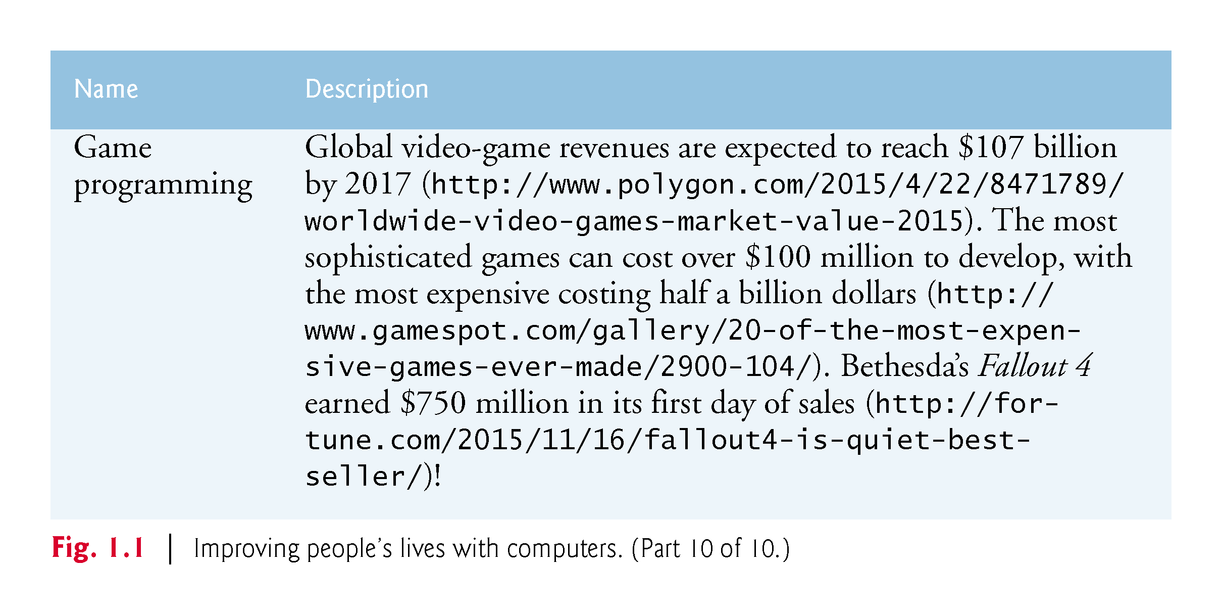

Slide 17
1.3 Hardware and Software
Computers can perform calculations and make logical decisions phenomenally faster than human beings can.
Today’s personal computers can perform billions of calculations in one second—more than a human can perform in a lifetime.
Supercomputers are already performing thousands of trillions (quadrillions) of instructions per second!
China’s National University of Defense Technology’s Tianhe-2 supercomputer can perform over 33 quadrillion calculations per second (33.86 petaflops)!
In one second about 3 million calculations for every person on the planet!

Slide 18
1.3 Hardware and Software
Computers (i.e., hardware) process data under the control of sequences of instructions called computer programs.
These programs guide the computer through actions specified by people called computer programmers.
The programs that run on a computer are referred to as software.

Slide 19
1.3.1 Moore’s Law
Every year, you probably expect to pay at least a little more for most products and services.
The opposite has been the case in the computer and communications fields, especially with regard to the hardware supporting these technologies. For many decades, hardware costs have fallen rapidly.
Every year or two, the capacities of computers have approximately- doubled inexpensively.
This remarkable trend often is called Moore’s Law, named for the person who identified it in the 1960s, Gordon Moore, co-founder of Intel—a leading manufacturer of the processors in today’s computers and embedded systems.

Slide 20
1.3.1 Moore’s Law
Moore’s Law and related observations apply especially to the amount of memory that computers have for programs, the amount of secondary storage (such as disk storage) they have to hold programs- and data over longer periods of time, and their processor speeds—the speeds at which they execute their programs (i.e., do their work).
These increases make computers more capable, which puts greater demands on programming-language designers to innovate.
Similar growth has occurred in the communications.

Slide 21
1.3.2 Computer Organization
Regardless of differences in physical appearance, computers can be envisioned as divided into various logical units or sections (Fig. 1.2).

Slide 22
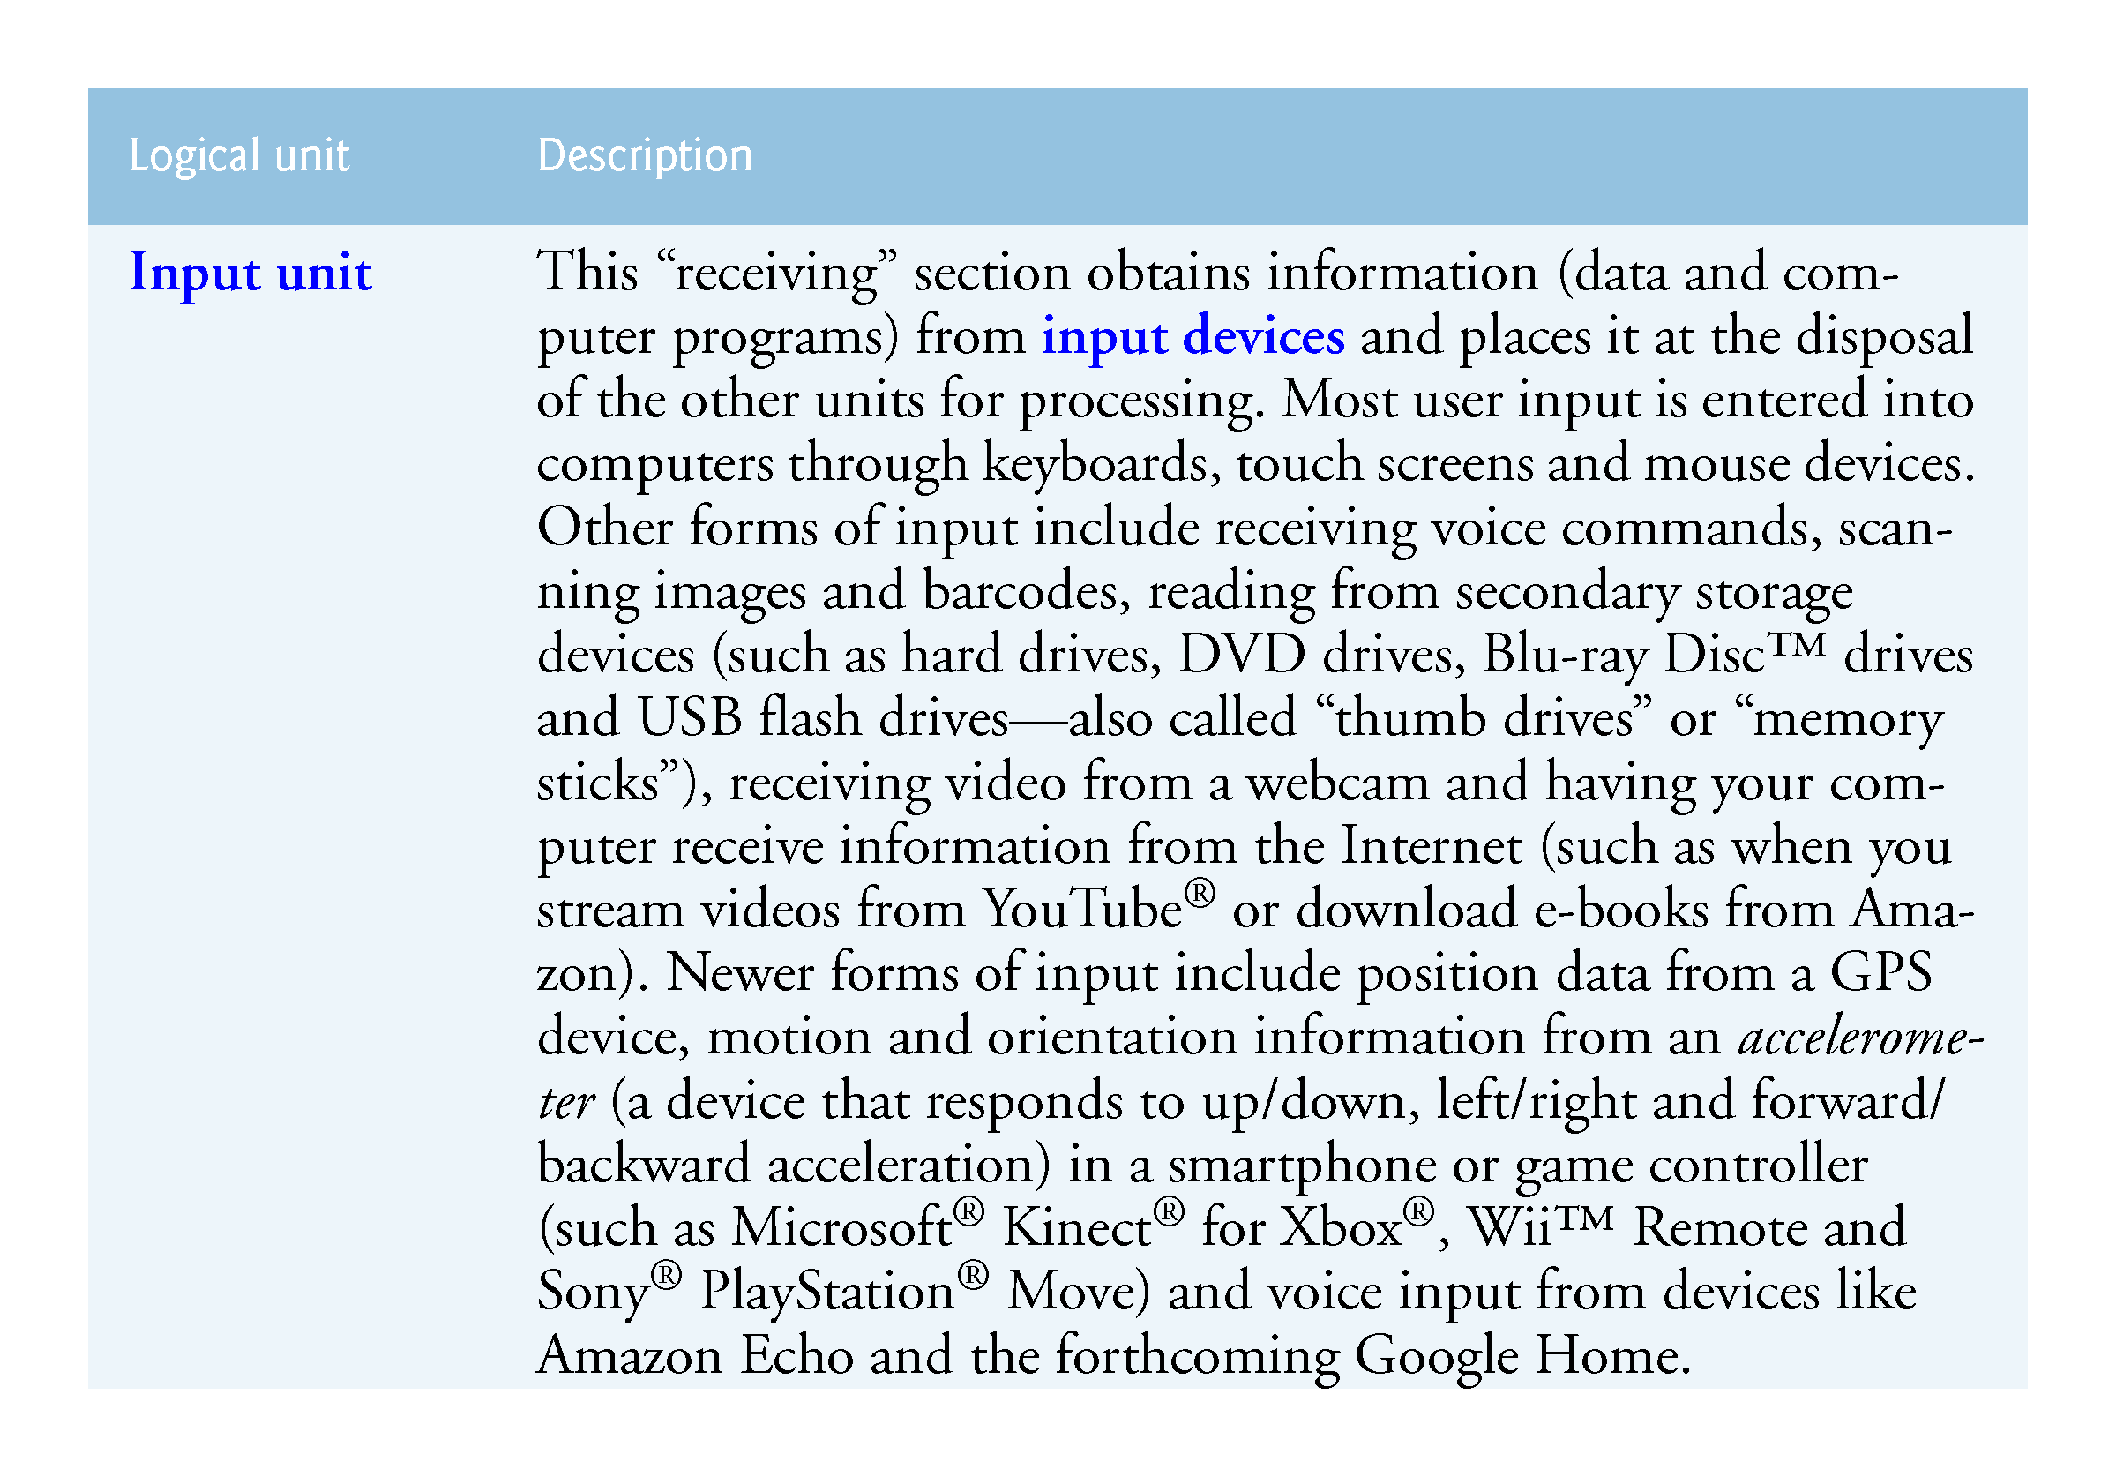

Slide 23
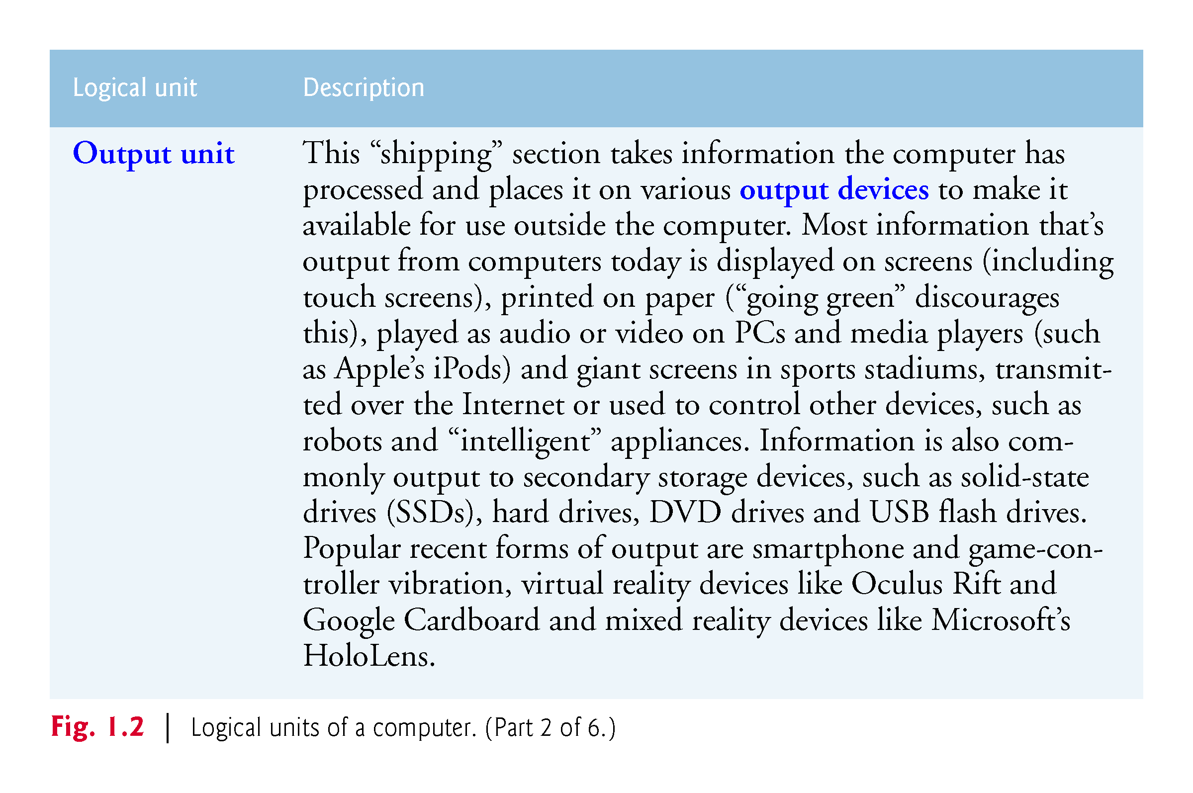

Slide 24
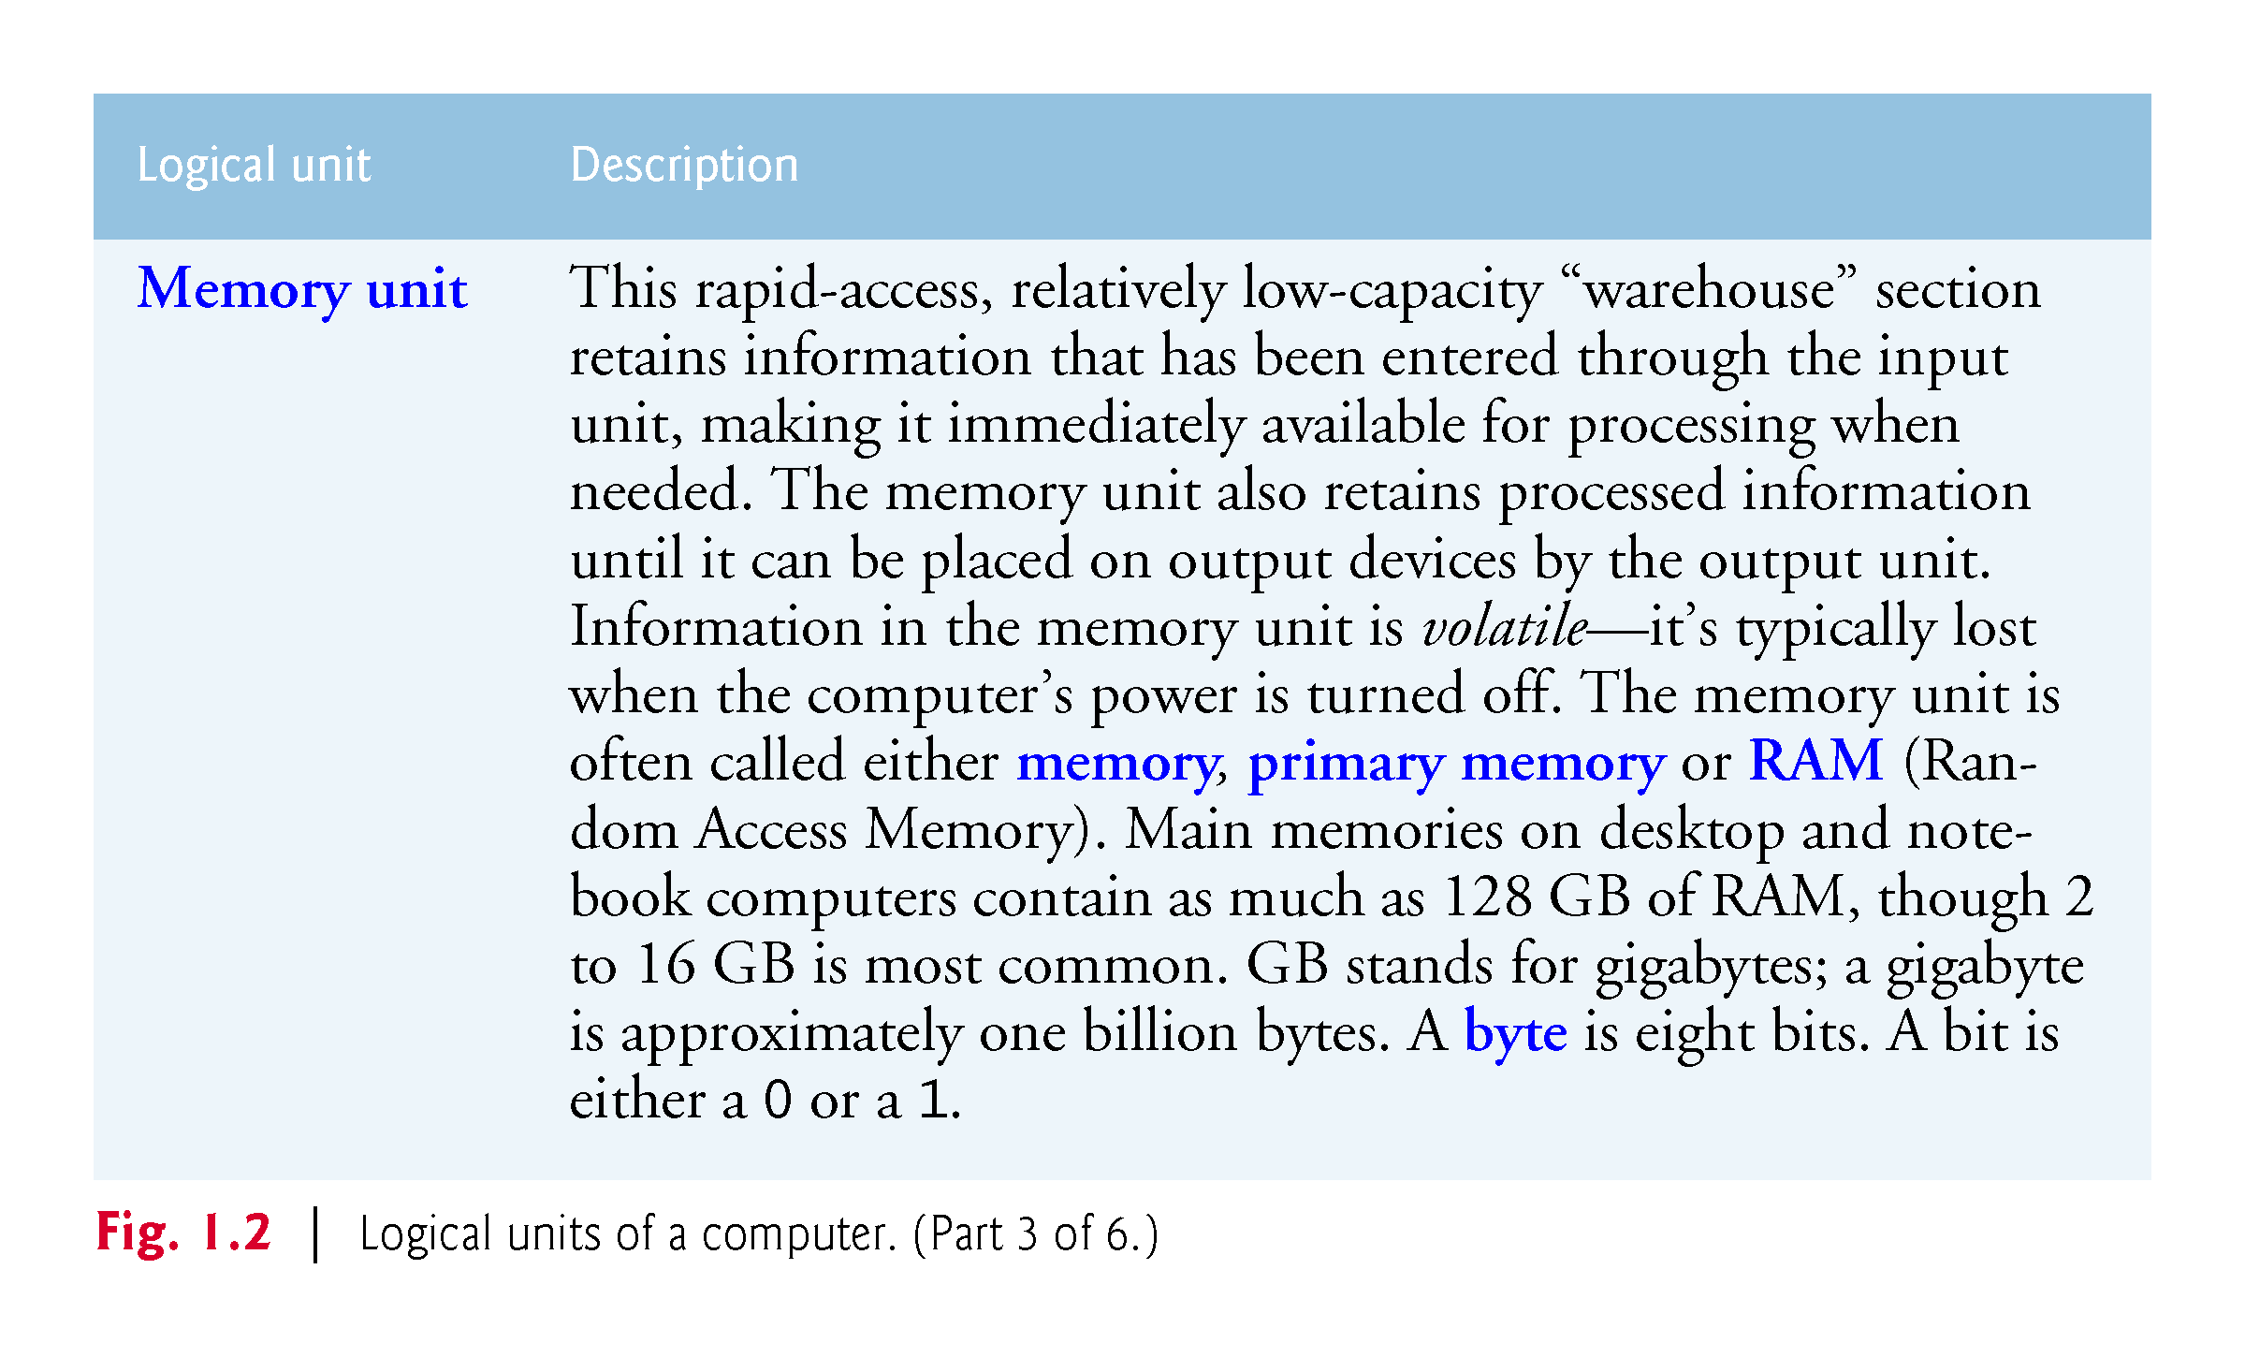

Slide 25
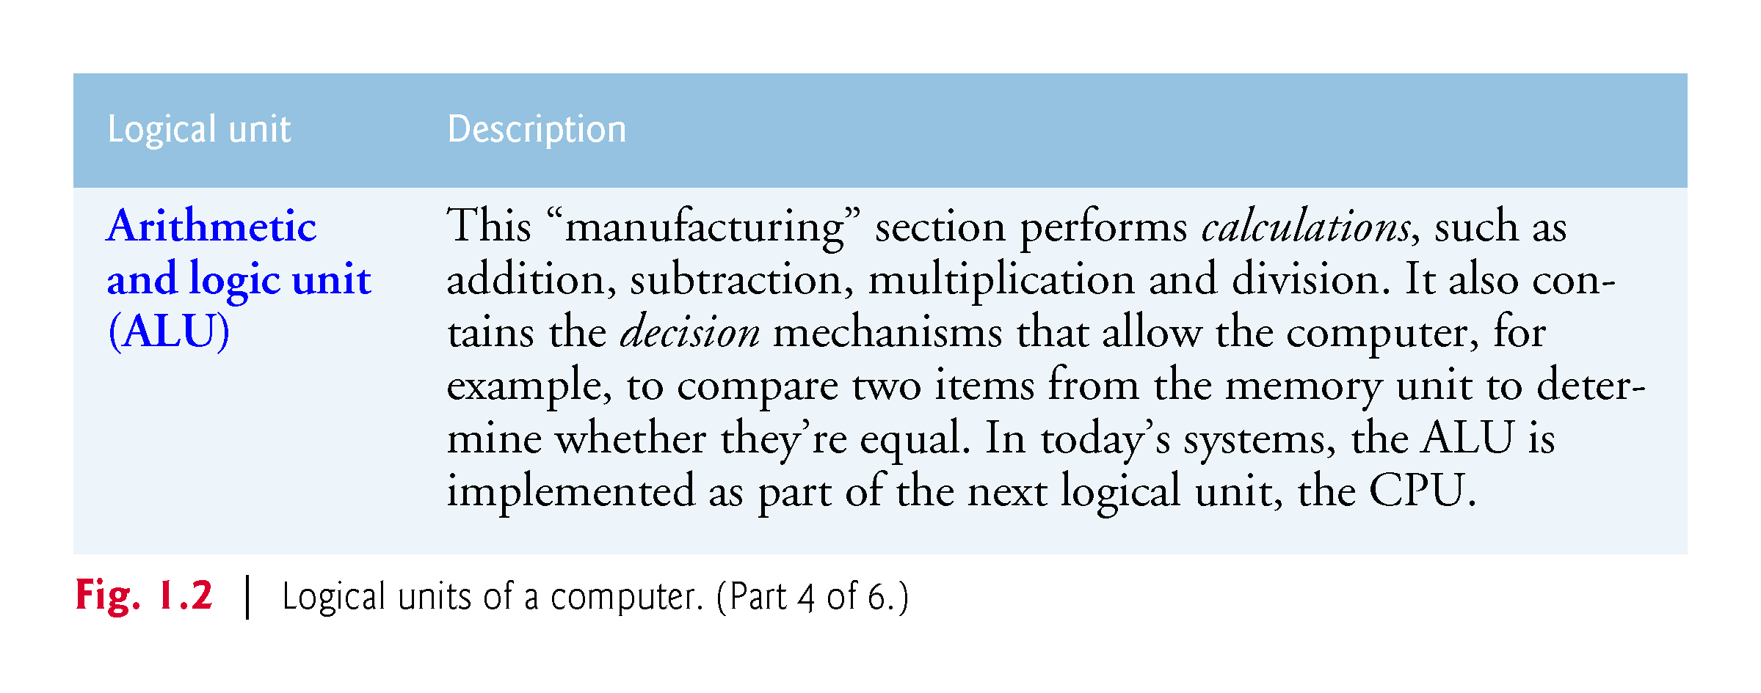

Slide 26
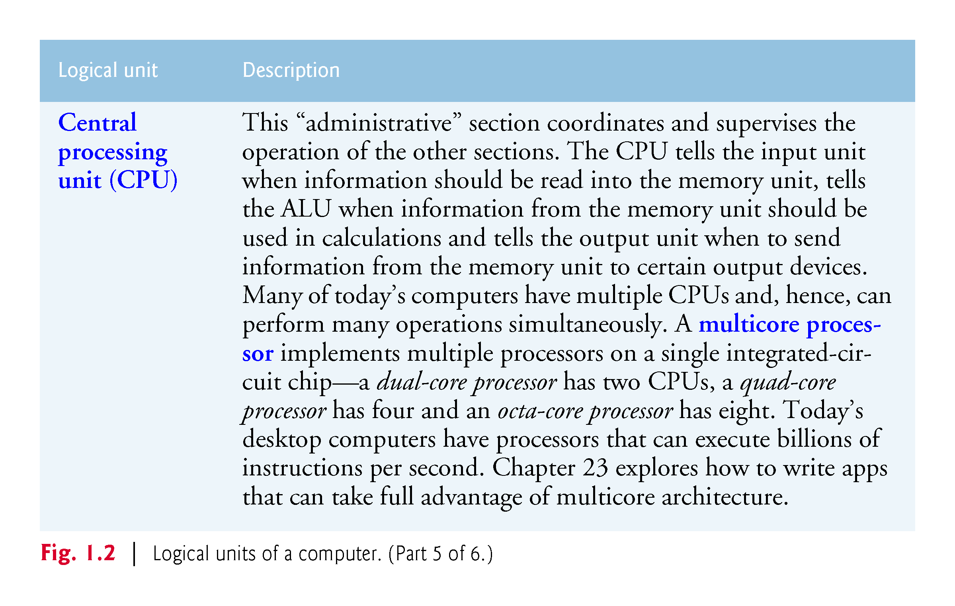

Slide 27
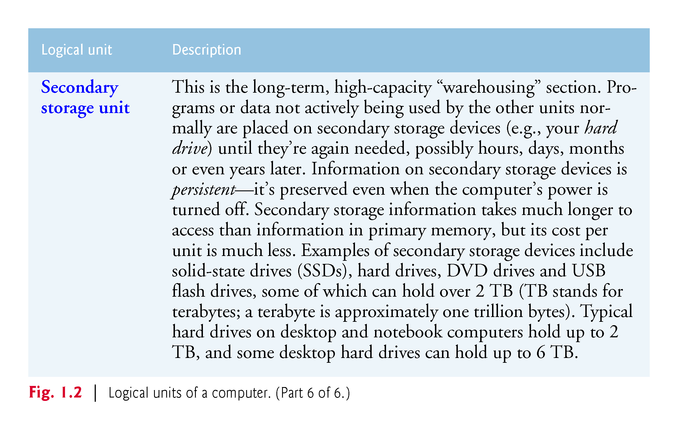

Slide 28
1.4 Data Hierarchy
Data items processed by computers form a data hierarchy that becomes larger and more complex in structure as we progress from the simplest data items (called “bits”) to richer data items, such as characters, fields, and so on.

Slide 29
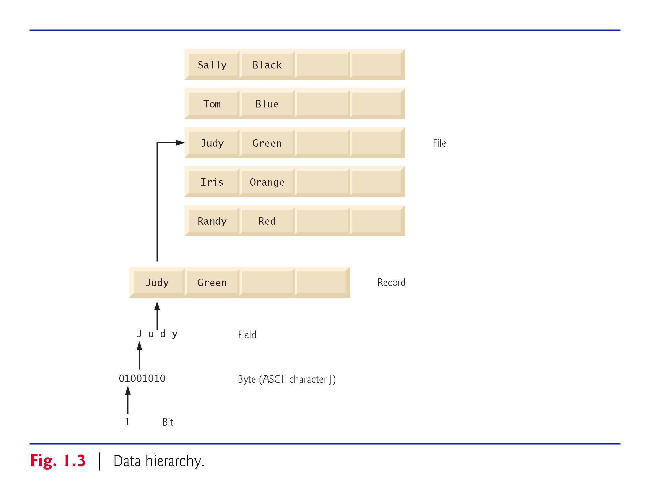

Slide 30
1.4 Data Hierarchy
Bits
The smallest data item in a computer can assume the value 0 or the value 1.
Such a data item is called a bit (short for “binary digit”—a digit that can assume either of two values).
It’s remarkable that the impressive functions performed by computers involve only the simplest manipulations of 0s and 1s—examining a bit’s value, setting a bit’s value and reversing a bit’s value (from 1 to 0 or from 0 to 1).

Slide 31
1.4 Data Hierarchy
Characters
We prefer to work with decimal digits (0–9), uppercase letters (A–Z), lowercase letters (a–z), and special symbols (e.g., $, @, %, &, *, (, ), –, +, ", :, ? and / ).
Digits, letters and special symbols are known as characters. The computer’s character set is the set of all the characters used to write programs and represent data items on that device.
Computers process only 1s and 0s, so every character is represented as a pattern of 1s and 0s.
The Unicode character set contains characters for many of the world’s languages.

Slide 32
1.4 Data Hierarchy
C# supports several character sets, including 16-bit Unicode® characters that are composed of two bytes—each byte is composed of eight bits.
See Appendix B for more information on the ASCII (American Standard Code for Information Interchange) character set—the popular subset of Unicode that represents uppercase and lowercase letters in the English alphabet, digits and some common special characters.

Slide 33
1.4 Data Hierarchy
Fields
Just as characters are composed of bits, fields are composed of characters or bytes.
A field is a group of characters or bytes that conveys meaning.
For example, a field consisting of uppercase and lowercase letters could be used to represent a person’s name, and a field consisting of decimal digits could represent a person’s age.

Slide 34
1.4 Data Hierarchy
Records
Several related fields can be used to compose a record.
In a payroll system, for example, the record for an employee might consist of the following fields (possible types for these fields are shown in parentheses):
Employee identification number (a whole number)
Name (a string of characters)
Address (a string of characters)
Hourly pay rate (a number with a decimal point)
Year-to-date earnings (a number with a decimal point)
Amount of taxes withheld (a number with a decimal point)
Thus, a record is a group of related fields.
In the preceding example, all the fields belong to the same employee.

Slide 35
1.4 Data Hierarchy
Files
A file is a group of related records.
More generally, a file contains arbitrary data in arbitrary formats.
In some operating systems, a file is viewed simply as a sequence of bytes—any organization of the bytes in a file, such as organizing the data into records, is a view created by the programmer.

Slide 36
1.4 Data Hierarchy
Database
A database is a collection of data that’s organized for easy access and manipulation.
The most popular database model is the relational database in which data is stored in simple tables.
A table includes records composed of fields.
For example, a table of students might include first name, last name, major, year, student ID number and grade point average fields.
The data for each student is a record, and the individual pieces of information in each record are the fields.
You can search, sort and otherwise manipulate the data based on its relationship to multiple tables or databases.

Slide 37
1.4 Data Hierarchy
The amount of data being produced worldwide is enormous and growing quickly.
Approximately 2.5 quintillion bytes (2.5 exabytes) of data are created daily, and as of October 2015 90% of the world’s data was created in just the prior 12 months.
Figure 1.4 shows some common byte measurements.
Big data applications deal with massive amounts of data and this field is growing quickly, creating lots of opportunity for software developers.

Slide 38
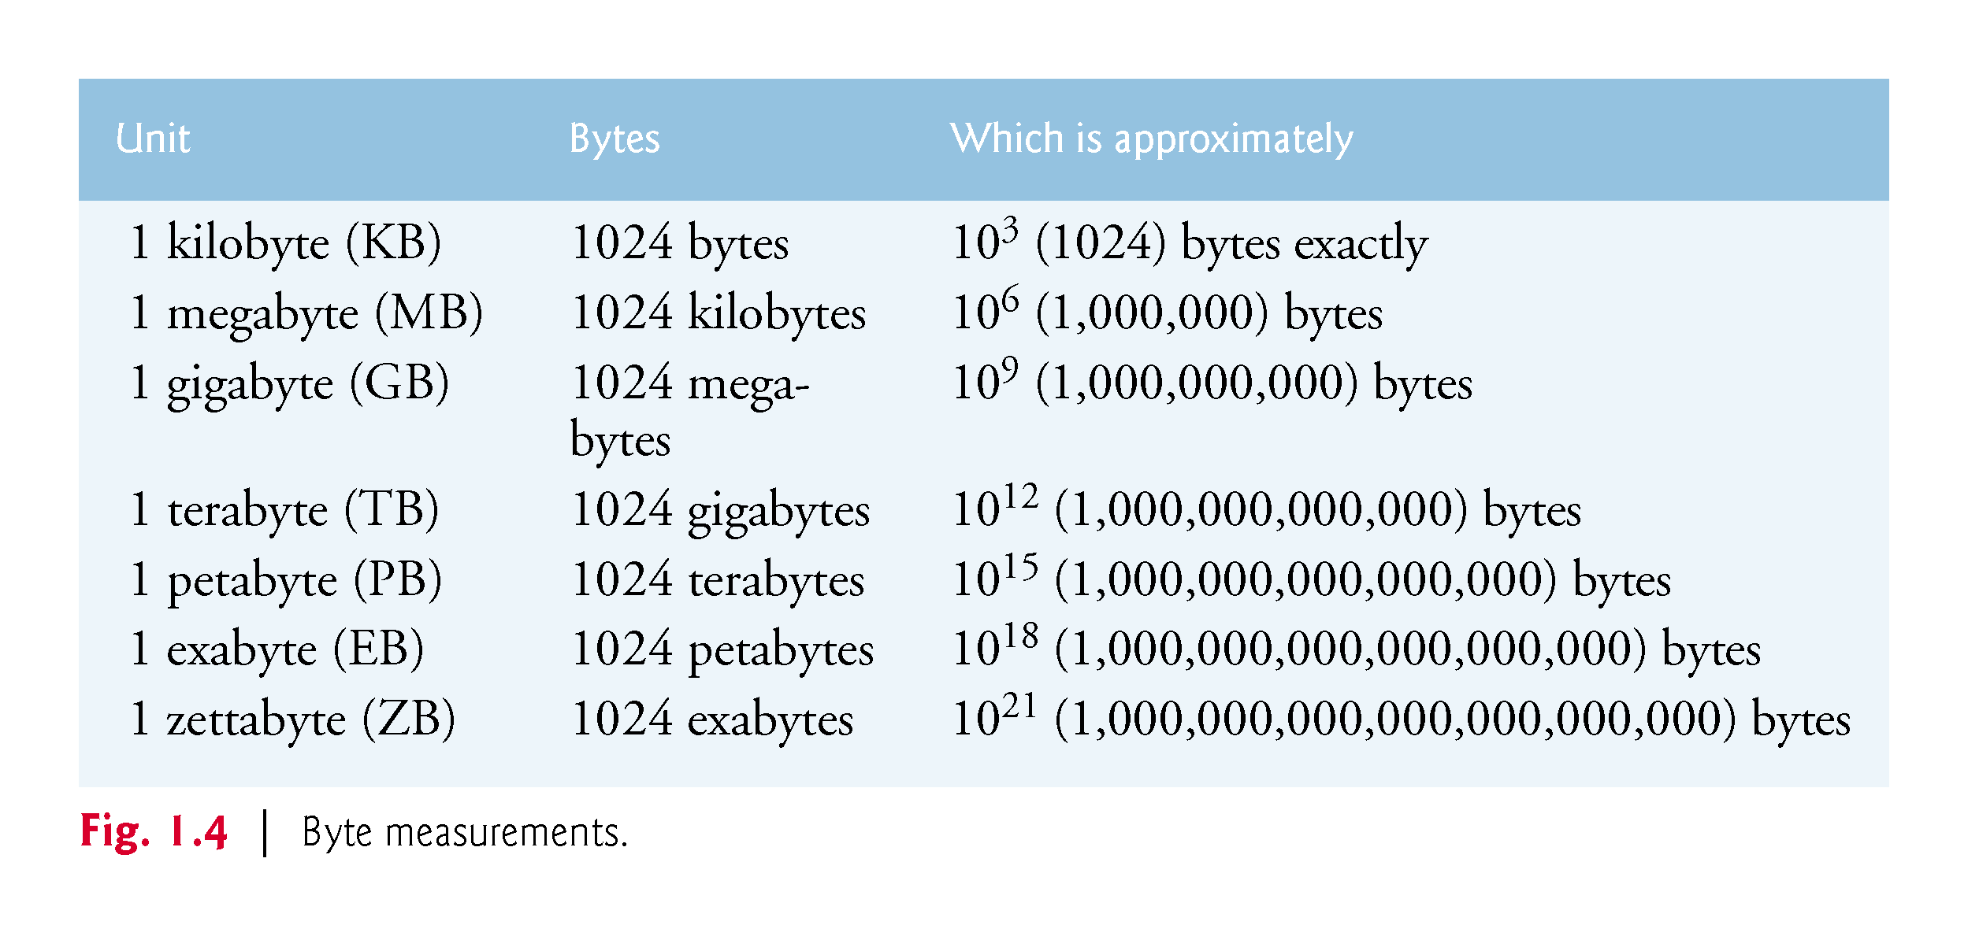

Slide 39
1.5 Machine Languages, Assembly Languages and High-Level Languages
Programmers write instructions in various programming languages, some directly understandable by computers and others requiring intermediate translation steps.
Any computer can directly understand only its own machine language (also called machine code), defined by its hard-ware architecture.
Machine languages generally consist of numbers (ultimately reduced to 1s and 0s). Such languages are cum-bersome for humans.

Slide 40
1.5 Machine Languages, Assembly Languages and High-Level Languages
English-like abbreviations formed the basis of assembly languages.
Translator programs called assemblers were developed to convert assembly-language programs to machine language.
Although assembly-language code is clearer to humans, it’s incomprehensible to computers until translated to machine language.

Slide 41
1.5 Machine Languages, Assembly Languages and High-Level Languages
High-level languages were developed in which single statements could be written to accomplish substantial tasks.
High-level languages, such as C#, Visual Basic, C, C++, Java and Swift, allow you to write instructions that look more like everyday English and contain commonly used mathematical notations.
Translator programs called compilers convert high-level language programs into machine language.
Interpreter programs execute high-level language programs directly (without the need for compilation), although more slowly than compiled programs.
Scripting languages such as the popular web languages JavaScript and PHP are processed by interpreters.

Slide 42
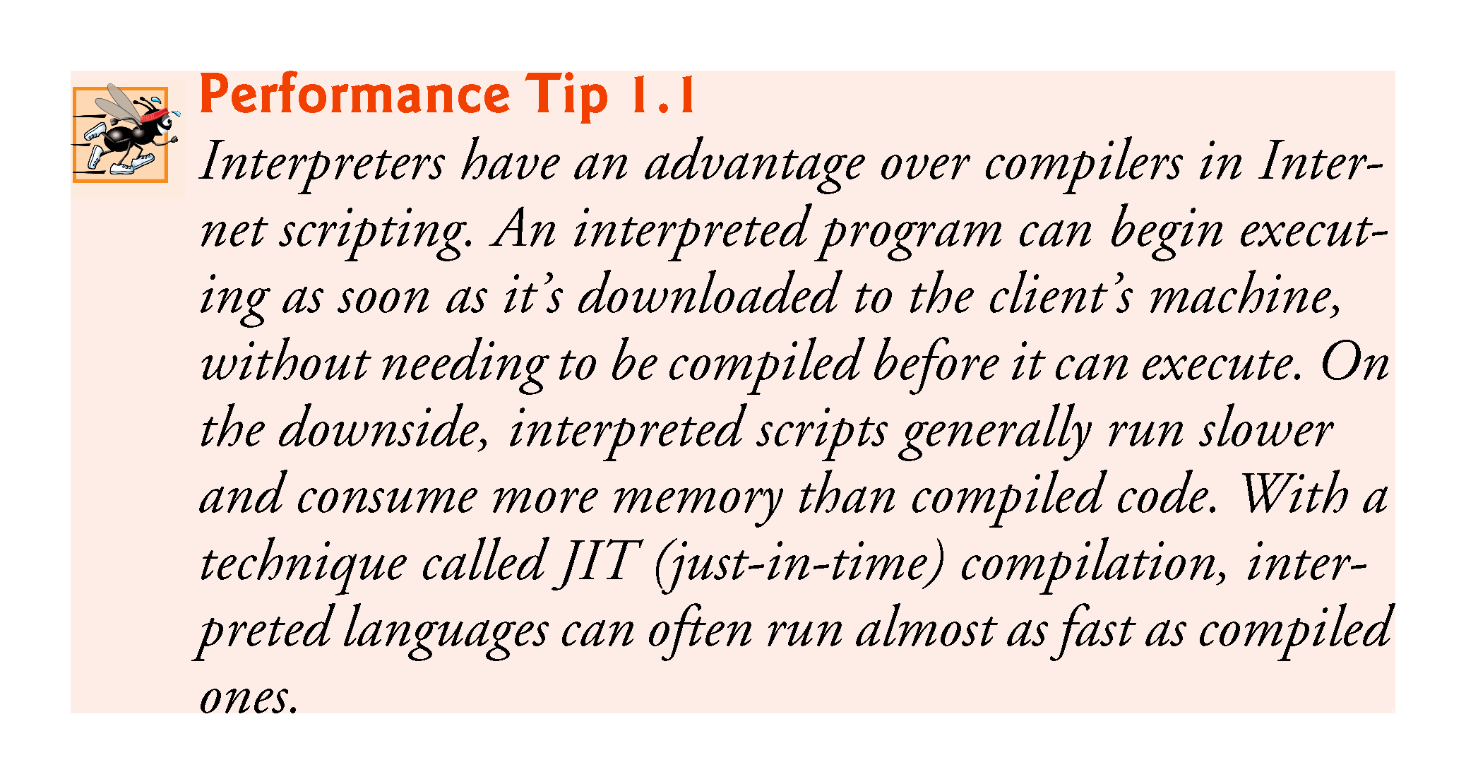

Slide 43
1.6 Object Technology
C# is an object-oriented programming language.
Objects, or more precisely—as we’ll see in Chapter 4—the classes objects come from, are essentially reusable software components.
Almost any noun can be reasonably represented as a software object in terms of attributes (e.g., name, color and size) and behaviors (e.g., calculating-, moving and communicating).
A modular, object-oriented design-and-implementation-approach can make software-development groups much more productive.

Slide 44
1.6 Object Technology
The Automobile as an Object
Suppose you want to drive a car and make it go faster by pressing its accelerator pedal. What must happen before you can do this?
Someone has to design it.
A car typically begins as engineering drawings, similar to the blueprints that describe the design of a house.
These drawings include the design for an accelerator pedal.
The pedal hides from the driver the complex mechanisms that actually make the car go faster, just as the brake pedal hides the mechanisms that slow the car, and the steering wheel hides the mechanisms that turn the car.

Slide 45
1.6 Object Technology
The Automobile as an Object
This enables people with little or no knowledge of how engines, braking and steering mechanisms work to drive a car easily.
Before you can drive a car, it must be built from the engineering drawings that describe it.
A completed car has an actual accelerator pedal to make the car go faster, but even that’s not enough—the car won’t accelerate on its own (hopefully!), so the driver must press the pedal to accelerate the car.

Slide 46
1.6 Object Technology
Methods and Classes
Performing a task in a program requires a method.
The method houses the program statements that actually perform the task.
It hides these statements from its user, just as a car’s accelerator pedal hides from the driver the mechanisms of making the car go faster.
In C#, we create a program unit called a class to house the set of methods that perform the class’s tasks.
A class is similar in concept to a car’s engineering drawings, which house the design of an accelerator pedal, steering wheel, and so on.

Slide 47
1.6 Object Technology
Making Objects from Classes
Just as someone has to build a car from its engineering drawings before you can actually drive a car, you must build an object from a class before a program can perform the tasks that the class’s methods define.
The process of doing this is called instantiation. An object is then referred to as an instance of its class.

Slide 48
1.6 Object Technology
Reuse
Just as a car’s engineering drawings can be reused many times to build many cars, you can reuse a class many times to build many objects.
Reuse of existing classes when building new classes and programs saves time and effort.
Reuse also helps you build more reliable and effective systems, because existing classes and components often have gone through extensive testing (to locate problems), debugging (to correct those problems) and performance tuning.

Slide 49
1.6 Object Technology
Messages and Method Calls
When you drive a car, pressing its gas pedal sends a message to the car to perform a task—that is, to go faster.
Similarly, you send messages to an object.
Each message is implemented as a method call that tells a method of the object to perform its task.

Slide 50
1.6 Object Technology
Attributes and Instance Variables
A car, besides having capabilities to accomplish tasks, also has attributes, such as its color, its number of doors, the amount of gas in its tank, its current speed and its record of total miles driven (i.e., its odometer reading).
An object, similarly, has attributes that it carries along as it’s used in a program. These attributes are specified as part of the object’s class.
Attributes are specified by the class’s instance variables.

Slide 51
1.6 Object Technology
Properties, get Accessors and set Accessors
Attributes are not necessarily accessible directly.
The car manufacturer does not want drivers to take apart the car’s engine to observe the amount of gas in its tank.
Instead, the driver can check the fuel gauge on the dashboard.
Similarly, you do not need to have access to an object’s instance variables in order to use them.
You should use the properties of an object.
Properties contain get accessors for reading the values of variables, and set accessors for storing values into them.

Slide 52
1.6 Object Technology
Encapsulation
Classes encapsulate (i.e., wrap) attributes and methods into objects created from those classes—an object’s attributes and methods are intimately related.
Objects may communicate with one another, but they’re normally not allowed to know how other objects are implemented—implementation details are hidden within the objects themselves.
This information hiding, as we’ll see, is crucial to good software engineering.

Slide 53
1.6 Object Technology
Inheritance
A new class of objects can be created quickly and conveniently by inheritance—the new class absorbs the characteristics of an existing class, possibly customizing them and adding unique characteristics of its own.
In our car analogy, an object of class “convertible” certainly is an object of the more general class “automobile,” but more specifically, the roof can be raised or lowered.

Slide 54
1.6 Object Technology
Object-Oriented Analysis and Design (OOAD)
To create the best solutions, you should follow a detailed analysis process for determining your project’s requirements (i.e., defining what the system is supposed to do) and developing a design that satisfies them (i.e., deciding how the system should do it).
Ideally, you’d go through this process and carefully review the design (and have your design reviewed by other software professionals) before writing any code.
If this process involves analyzing and designing your system from an object-oriented point of view, it’s called an object-oriented analysis and design (OOAD) process.

Slide 55
1.6 Object Technology
The UML (Unified Modeling Language)
Although many different OOAD processes exist, a single graphical language for communicating the results of any OOAD process has come into wide use.
This language, known as the Unified Modeling Language (UML), is now the most widely used graphical scheme for modeling object-oriented systems.

Slide 56
1.7 Internet and World Wide Web
In the late 1960s, ARPA—the Advanced Research Projects Agency of the Department of Defense—rolled out plans to network the main computer systems of approximately a dozen ARPA-funded universities and research institutions.
ARPA implemented what quickly became known as the ARPAnet, the precursor of today’s Internet.
Its main benefit proved to be the capability for quick and easy communication via e-mail.
This is true even on today’s Internet, with e-mail, instant messaging, file transfer and social media such as Facebook and Twitter, enabling billions of people worldwide to communicate quickly and easily.

Slide 57
1.7 Internet and World Wide Web
The protocol (set of rules) for communicating over the ARPAnet became known as the Transmission Control Protocol (TCP).
TCP ensured that messages, consisting of sequentially numbered pieces called packets, were properly routed from sender to receiver, arrived intact and were assembled in the correct order.

Slide 58
1.7 Internet and World Wide Web
The Internet: A Network of Networks
In parallel with the early evolution of the Internet, organizations worldwide were implementing their own networks for both intraorganization (that is, within an organization) and interorganization (that is, between organizations) communication.
One challenge was to enable these different networks to communicate with each other.
The Internet Protocol (IP) created a true “network of networks,” the current architecture of the Internet.
The combined set of protocols is now called TCP/IP.

Slide 59
1.7 Internet and World Wide Web
Businesses rapidly realized that by using the Internet, they could improve their operations and offer new and better services to their clients.
This generated fierce competition among communications carriers and hardware and software suppliers to meet the increased infrastructure demand.
As a result, bandwidth—the information-carrying capacity of communications lines—on the Internet has increased tremendously, while hardware costs have plummeted.

Slide 60
1.7 Internet and World Wide Web
The World Wide Web (simply called “the web”) is a collection of hardware and software associated with the Internet that allows computer users to locate and view multimedia-based documents (documents with various combinations of text, graphics, animations, audios and videos) on almost any subject.

Slide 61
1.7 Internet and World Wide Web
In 1989, Tim Berners-Lee of CERN (the European Organization for Nuclear Research) began to develop a technology for sharing information via “hyperlinked” text documents.
Berners-Lee called his invention the HyperText Markup Language (HTML).
He also wrote communication protocols such as HyperText Transfer Protocol (HTTP) to form the backbone of his new hypertext information system, which he referred to as the World Wide Web.

Slide 62
1.7 Internet and World Wide Web
In 1994, Berners-Lee founded the World Wide Web Consortium (W3C), devoted to developing web technologies.
One of the W3C’s goals is to make the web accessible to everyone regardless of disabilities, language or culture.
You’ll use C# and other Microsoft technologies to build web-based apps.

Slide 63
1.8 C#
In 2000, Microsoft announced the C# programming language.
C# has roots in the C, C++ and Java programming languages.

Slide 64
1.8.1 Object-Oriented Programming
C# is object oriented—we’ve discussed the basics of object technology and we present a rich treatment of object-oriented programming throughout the book.
C# has access to the powerful .NET Framework Class Library—a vast collection of prebuilt classes that enable- you to develop apps quickly (Fig. 1.5).

Slide 65
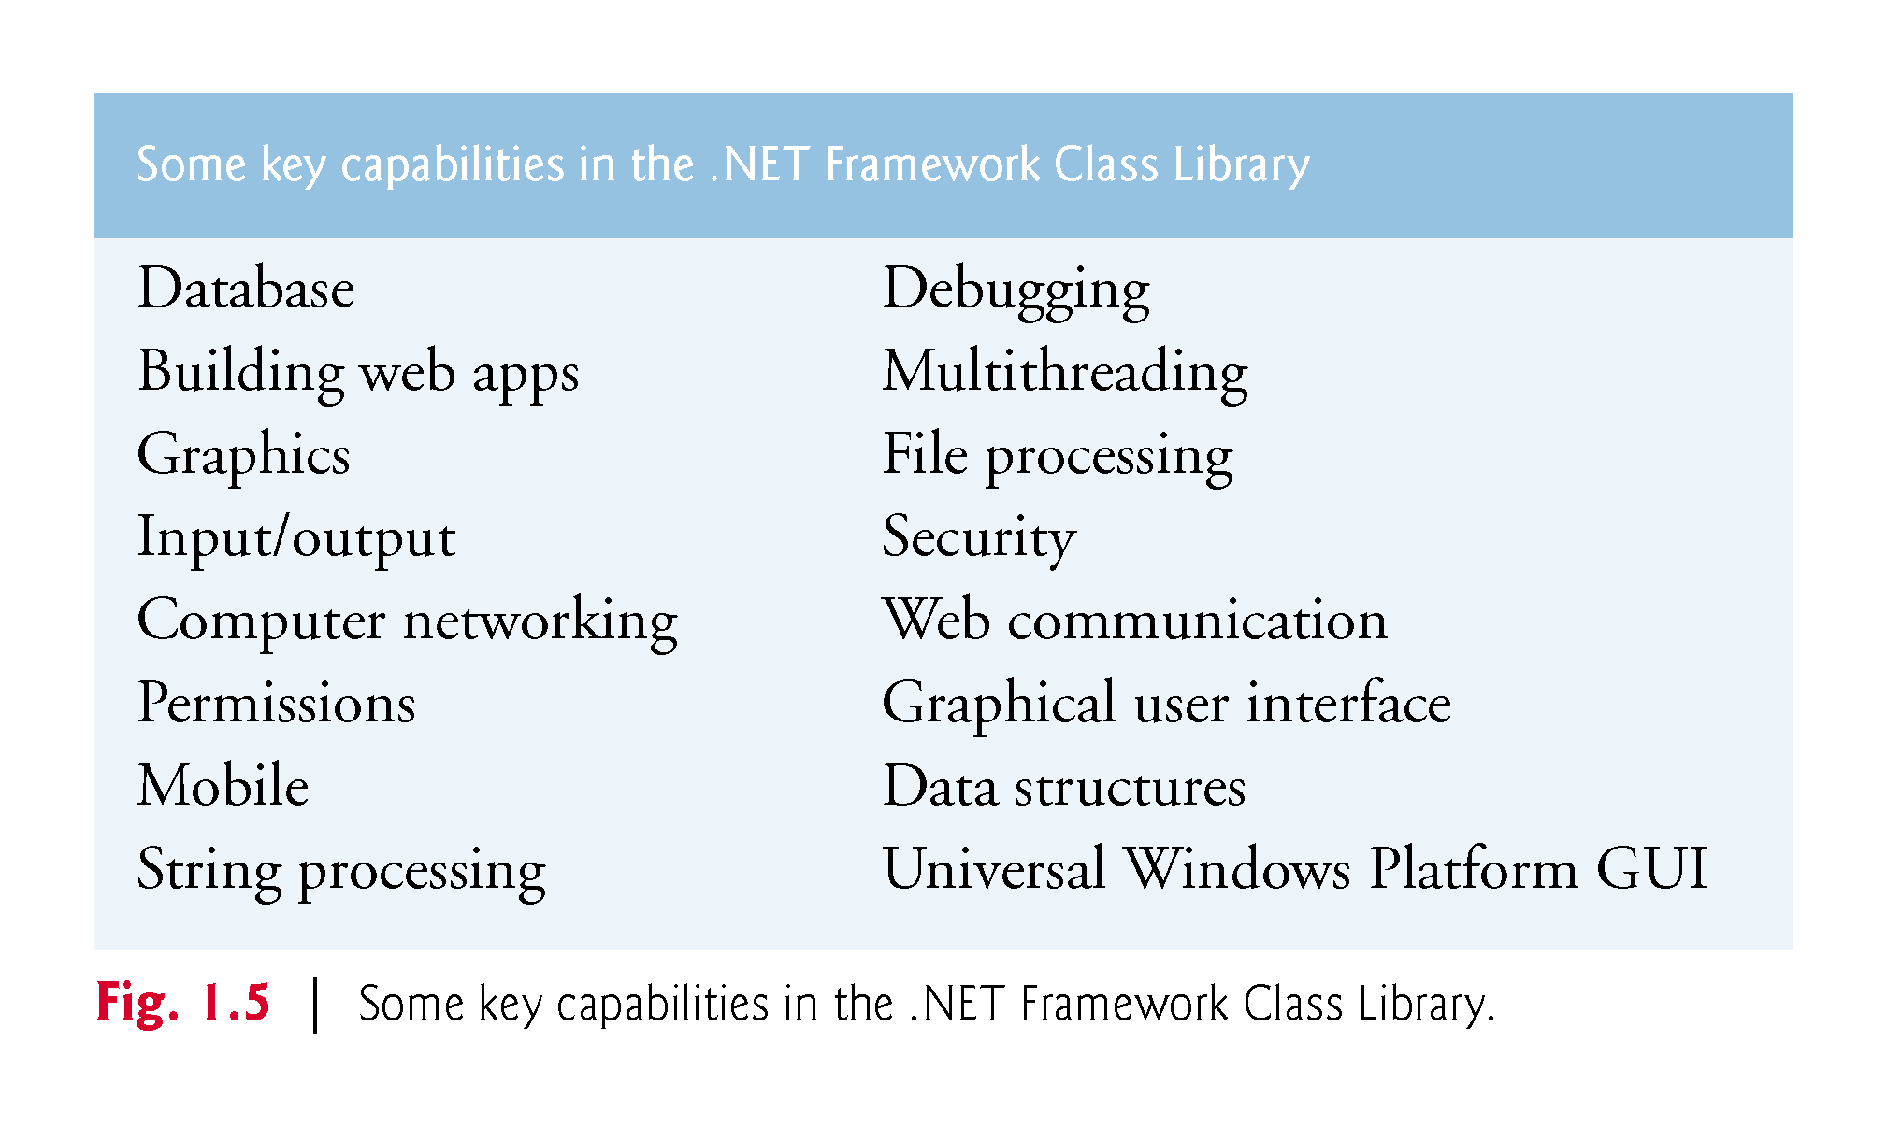

Slide 66
1.8.2 Event-Driven Programming
C# graphical user interfaces (GUIs) are event driven.
You can write programs that respond to user-initiated events such as mouse clicks, keystrokes, timer expirations and touches and finger swipes—gestures that are widely used on smartphones and tablets.

Slide 67
1.8.3 Visual Programming
Microsoft’s Visual Studio enables you to use C# as a visual programming language.
You’ll use Visual Studio to conveniently drag and drop predefined GUI objects like buttons and textboxes into place on your screen, and label and resize them.
Visual Studio will write much of the GUI code for you.

Slide 68
18.4 Generic and Functional Programming
Generic Programming
It’s common to write a program that processes a collection of things.
Historically, you had to program separately to handle each type of collection.
With generic programming, you write code that handles a collection “in the general” and C# handles the specifics for each different type of collection.

Slide 69
1.8.4 Generic and Functional Programming
Functional Programming
With functional programming, you specify what you want to accomplish in a task, but not how to accomplish it.
For example, with Microsoft’s LINQ you can say, “Here’s a collection of numbers, give me the sum of its elements.”
You do not need to specify the mechanics of walking through the elements and adding them into a running total one at a time—LINQ handles all that for you.
Functional programming speeds application development and reduces errors.

Slide 70
1.8.5 An International Standard
C# has been standardized through ECMA International:
http://www.ecma-international.org
At the time of this writing, the C# standard document—ECMA-334—was still being updated for C# 6.
For information on ECMA-334, visit
http://www.ecma-international.org/publications/standards/Ecma-334.htm
Visit the Microsoft download center to find the latest version of Microsoft’s C# 6 specification, other documentation and software downloads.

Slide 71
1.8.6 C# on Non-Windows Platforms
Though C# was originally developed by Microsoft for the Windows platform, the language can be used on other platforms via the Mono Project and .NET Core—both are managed by the .NET Foundation
http://www.dotnetfoundation.org/

Slide 72
1.8.7 Internet and Web Programming
Today’s apps can be written with the aim of communicating among the world’s computers.
This is the focus of Microsoft’s .NET strategy.

Slide 73
1.8.7 Internet and Web Programming
Today’s apps can be written with the aim of communicating among the world’s computers.
This is the focus of Microsoft’s .NET strategy.

Slide 74
1.8.8. Asynchronous Programming with async and await
In most programming today, each task in a program must finish executing before the next task can begin.
This is called synchronous programming and is the style we use for most of this book.
C# also allows asynchronous programming in which multiple tasks can be performed at the same time.
Asynchronous programming can help you make your apps more responsive to user interactions, such as mouse clicks and keystrokes, among many other uses.

Slide 75
1.8.8. Asynchronous Programming with async and await
Asynchronous programming in early versions of Visual C# was difficult and error prone.
C#’s async and await capabilities simplify asynchronous programming by enabling the compiler to hide much of the associated complexity from the developer.

Slide 76
1.8.9 Other Key Programming Languages
Figure 1.6 provides brief comments on several popular programming languages.

Slide 77
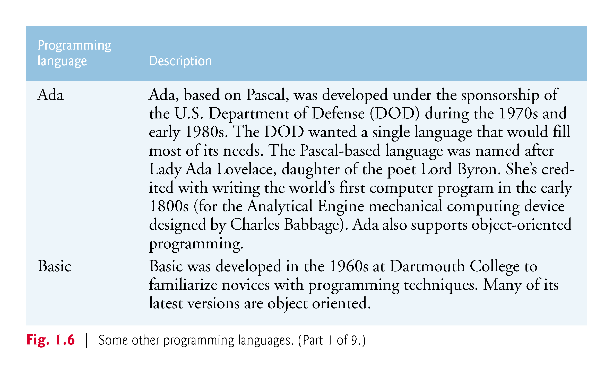

Slide 78
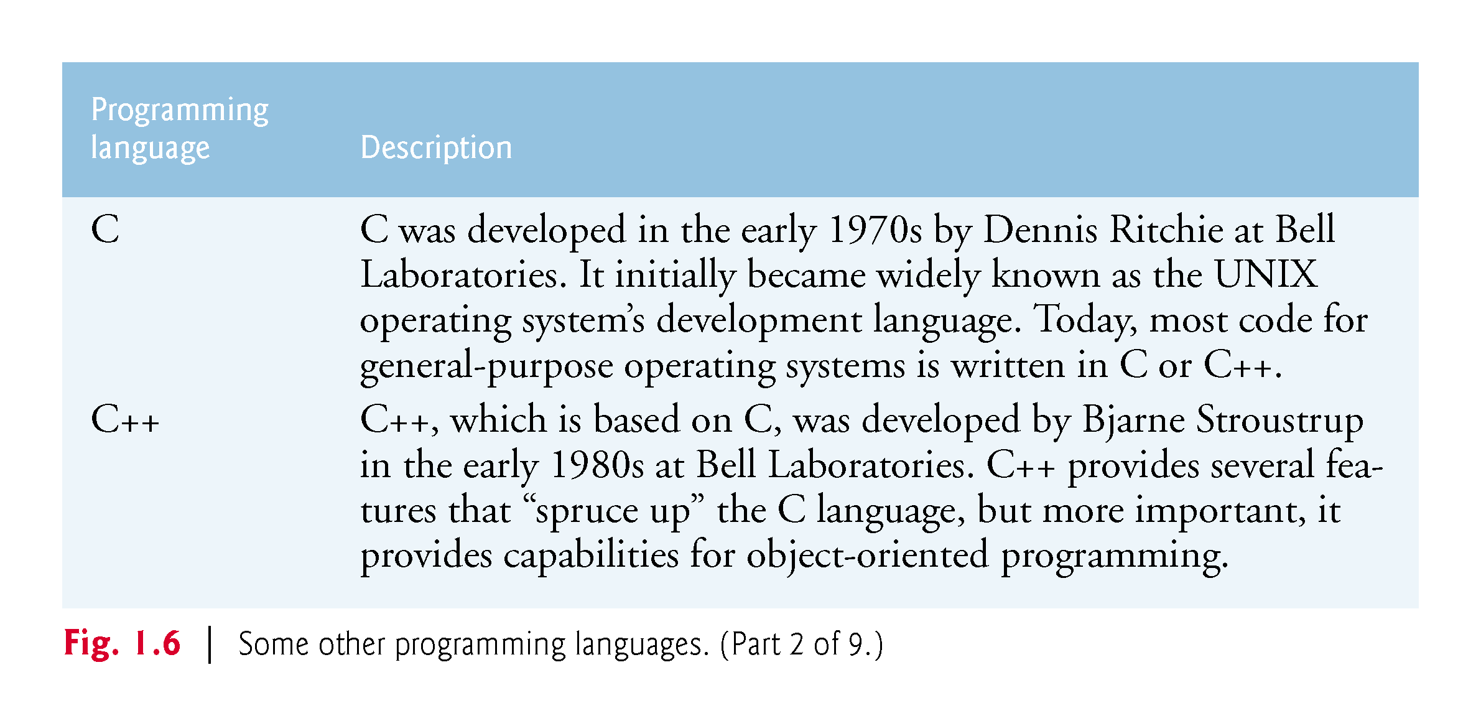

Slide 79
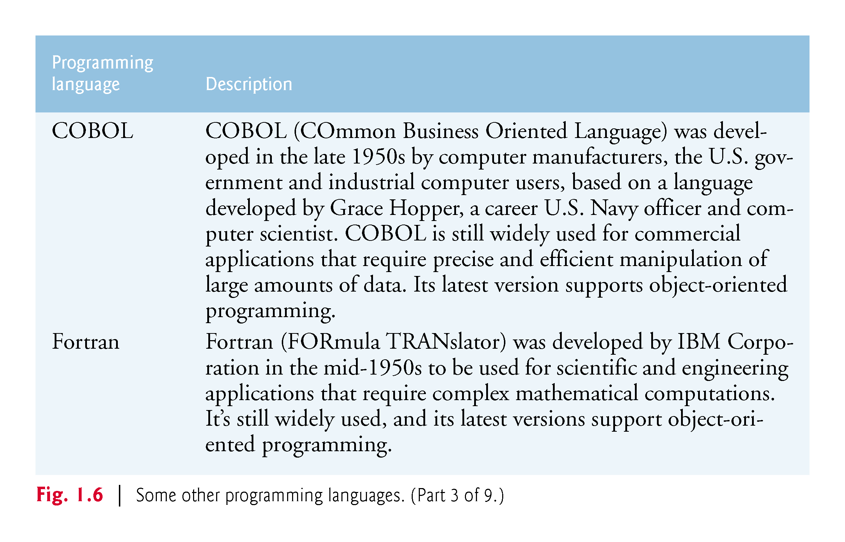

Slide 80
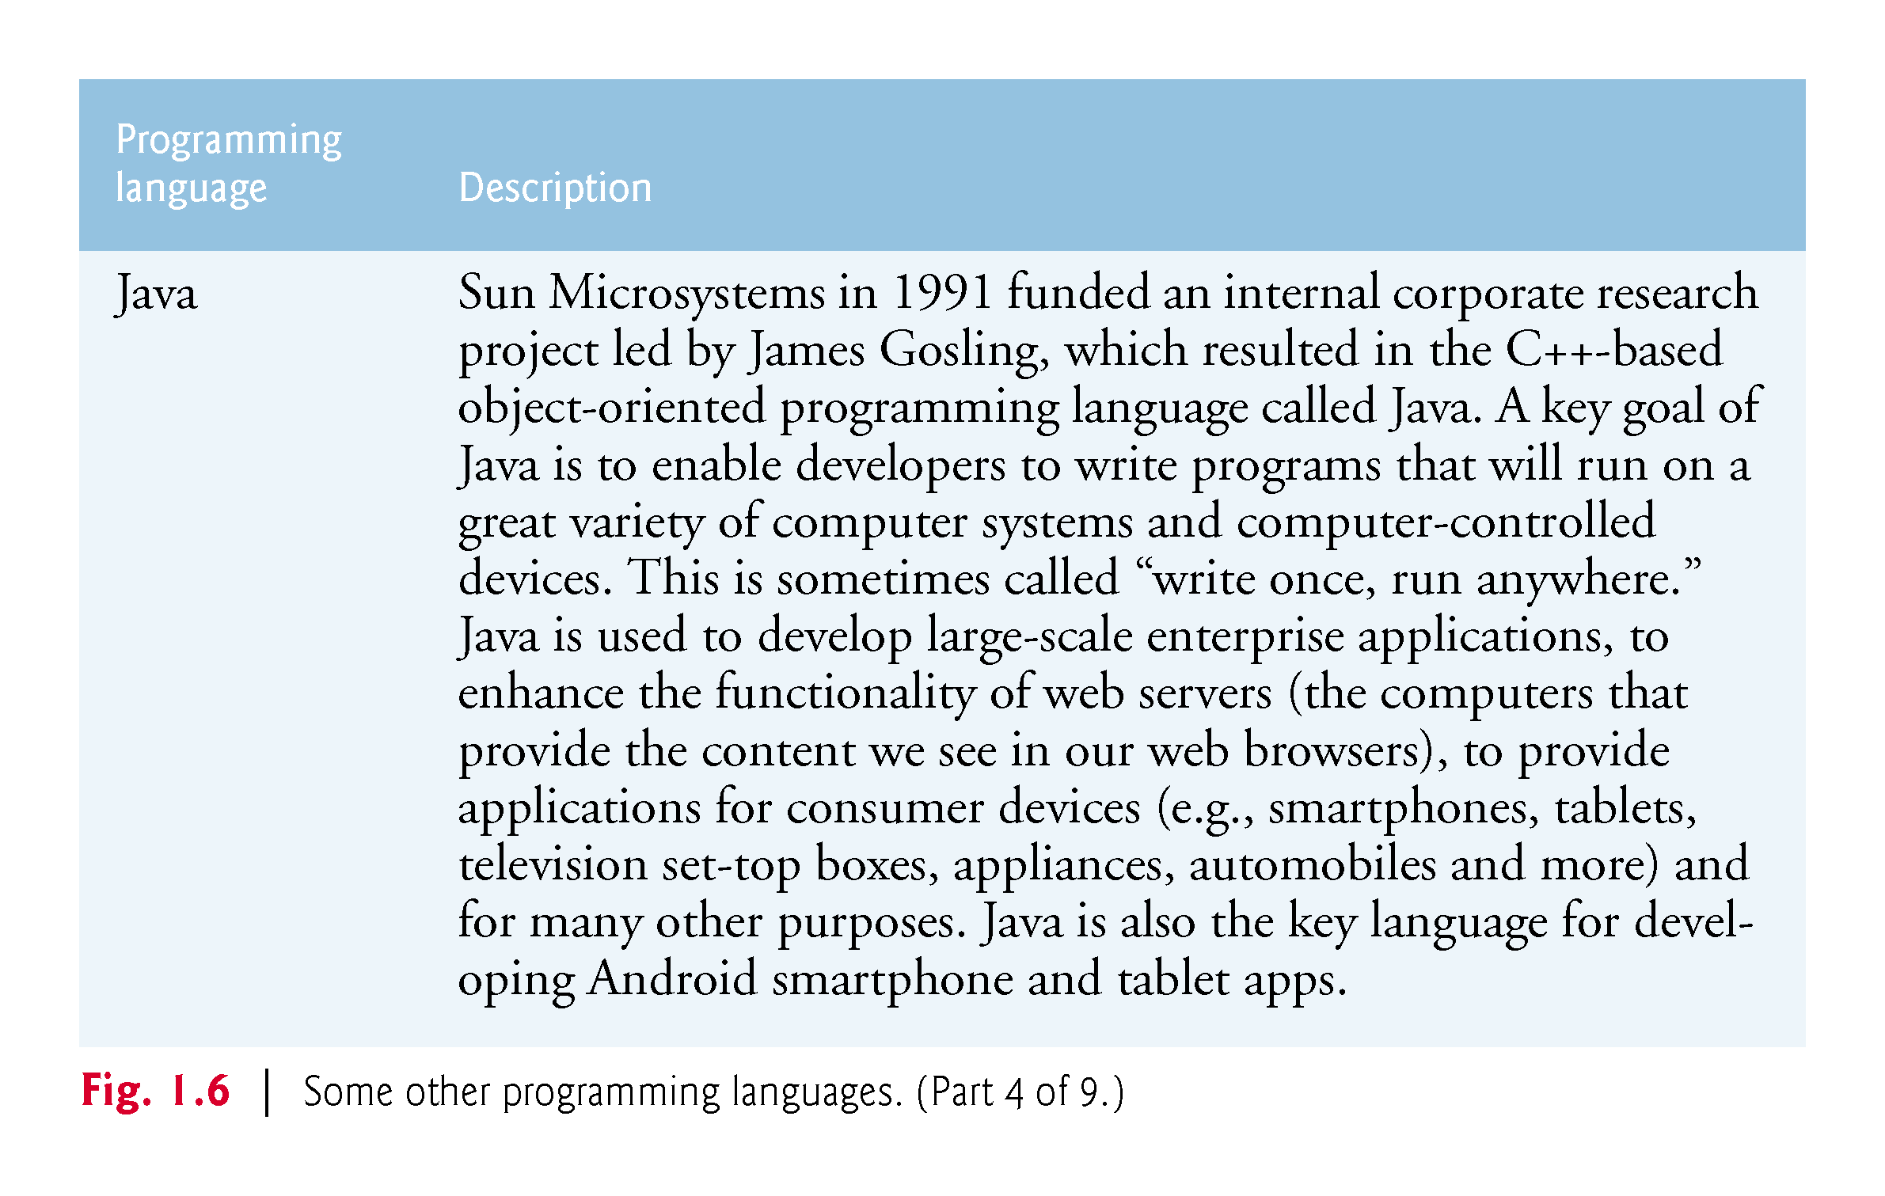

Slide 81
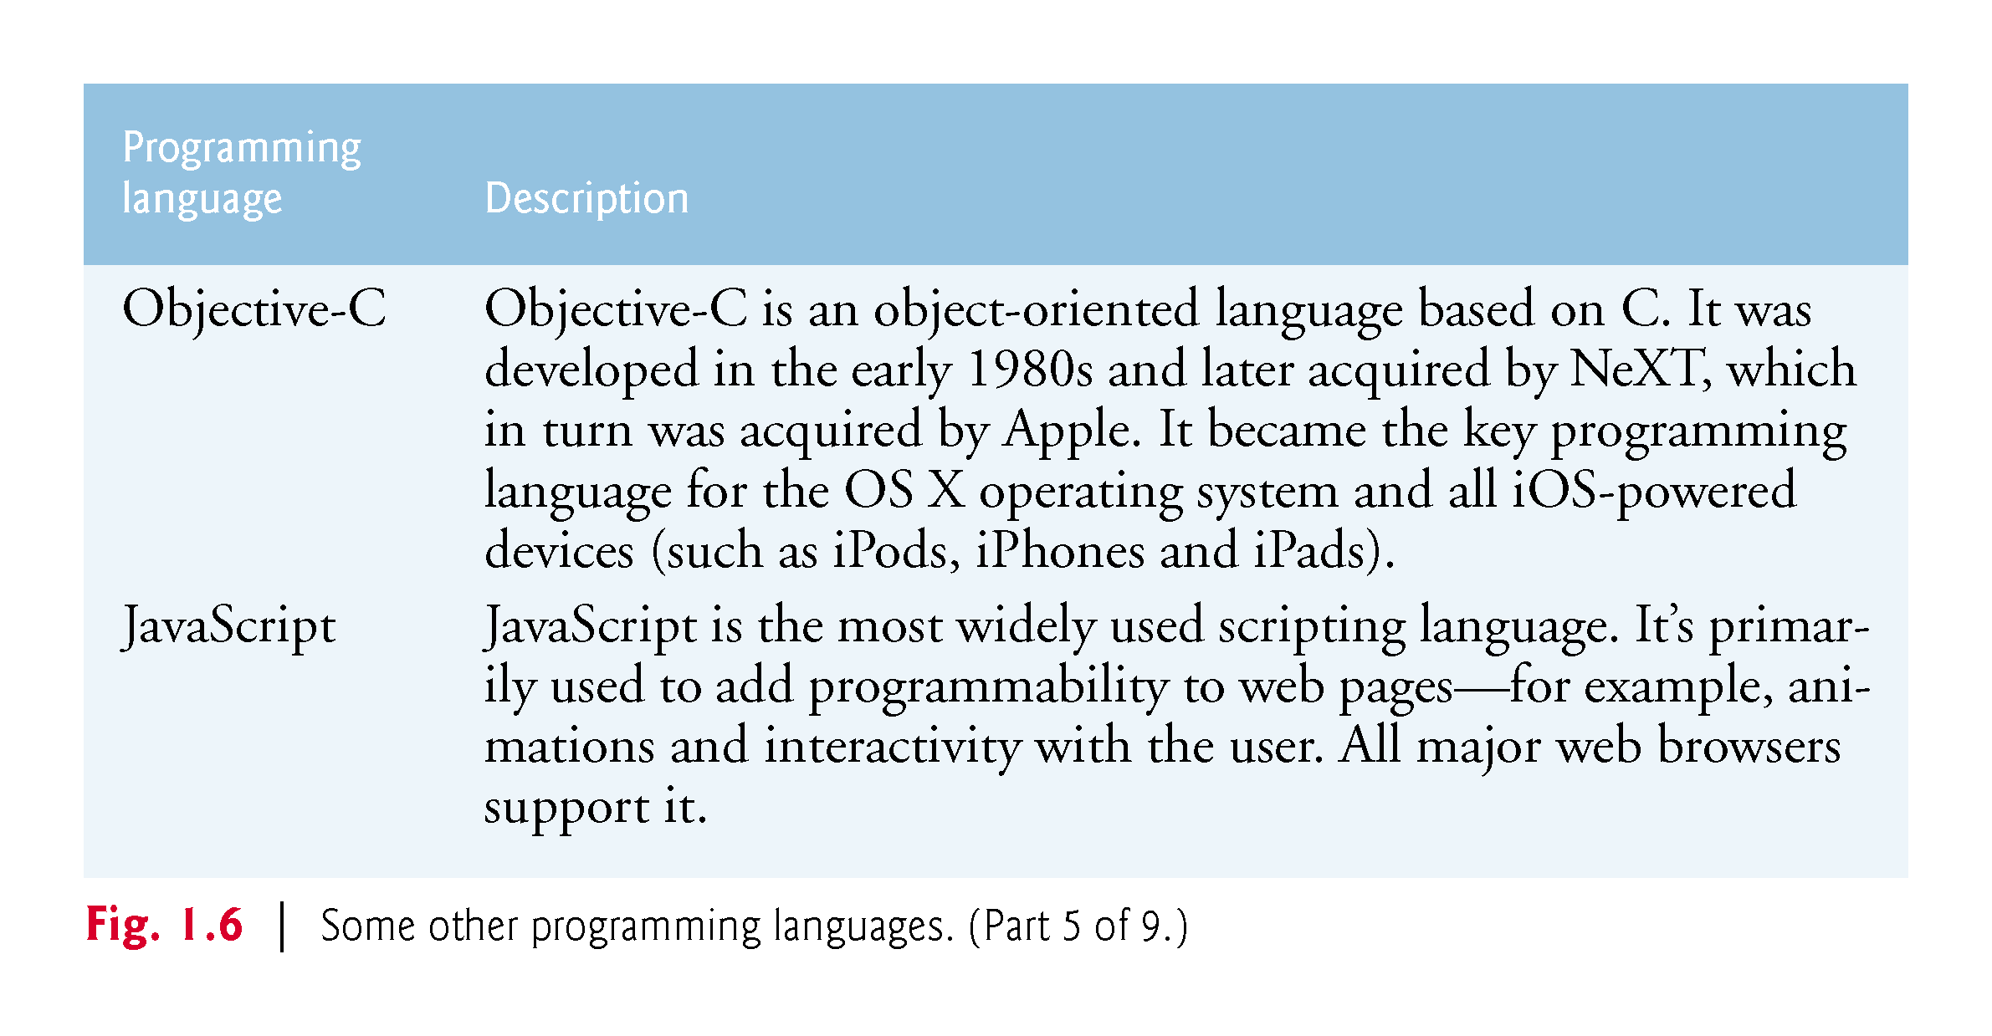

Slide 82
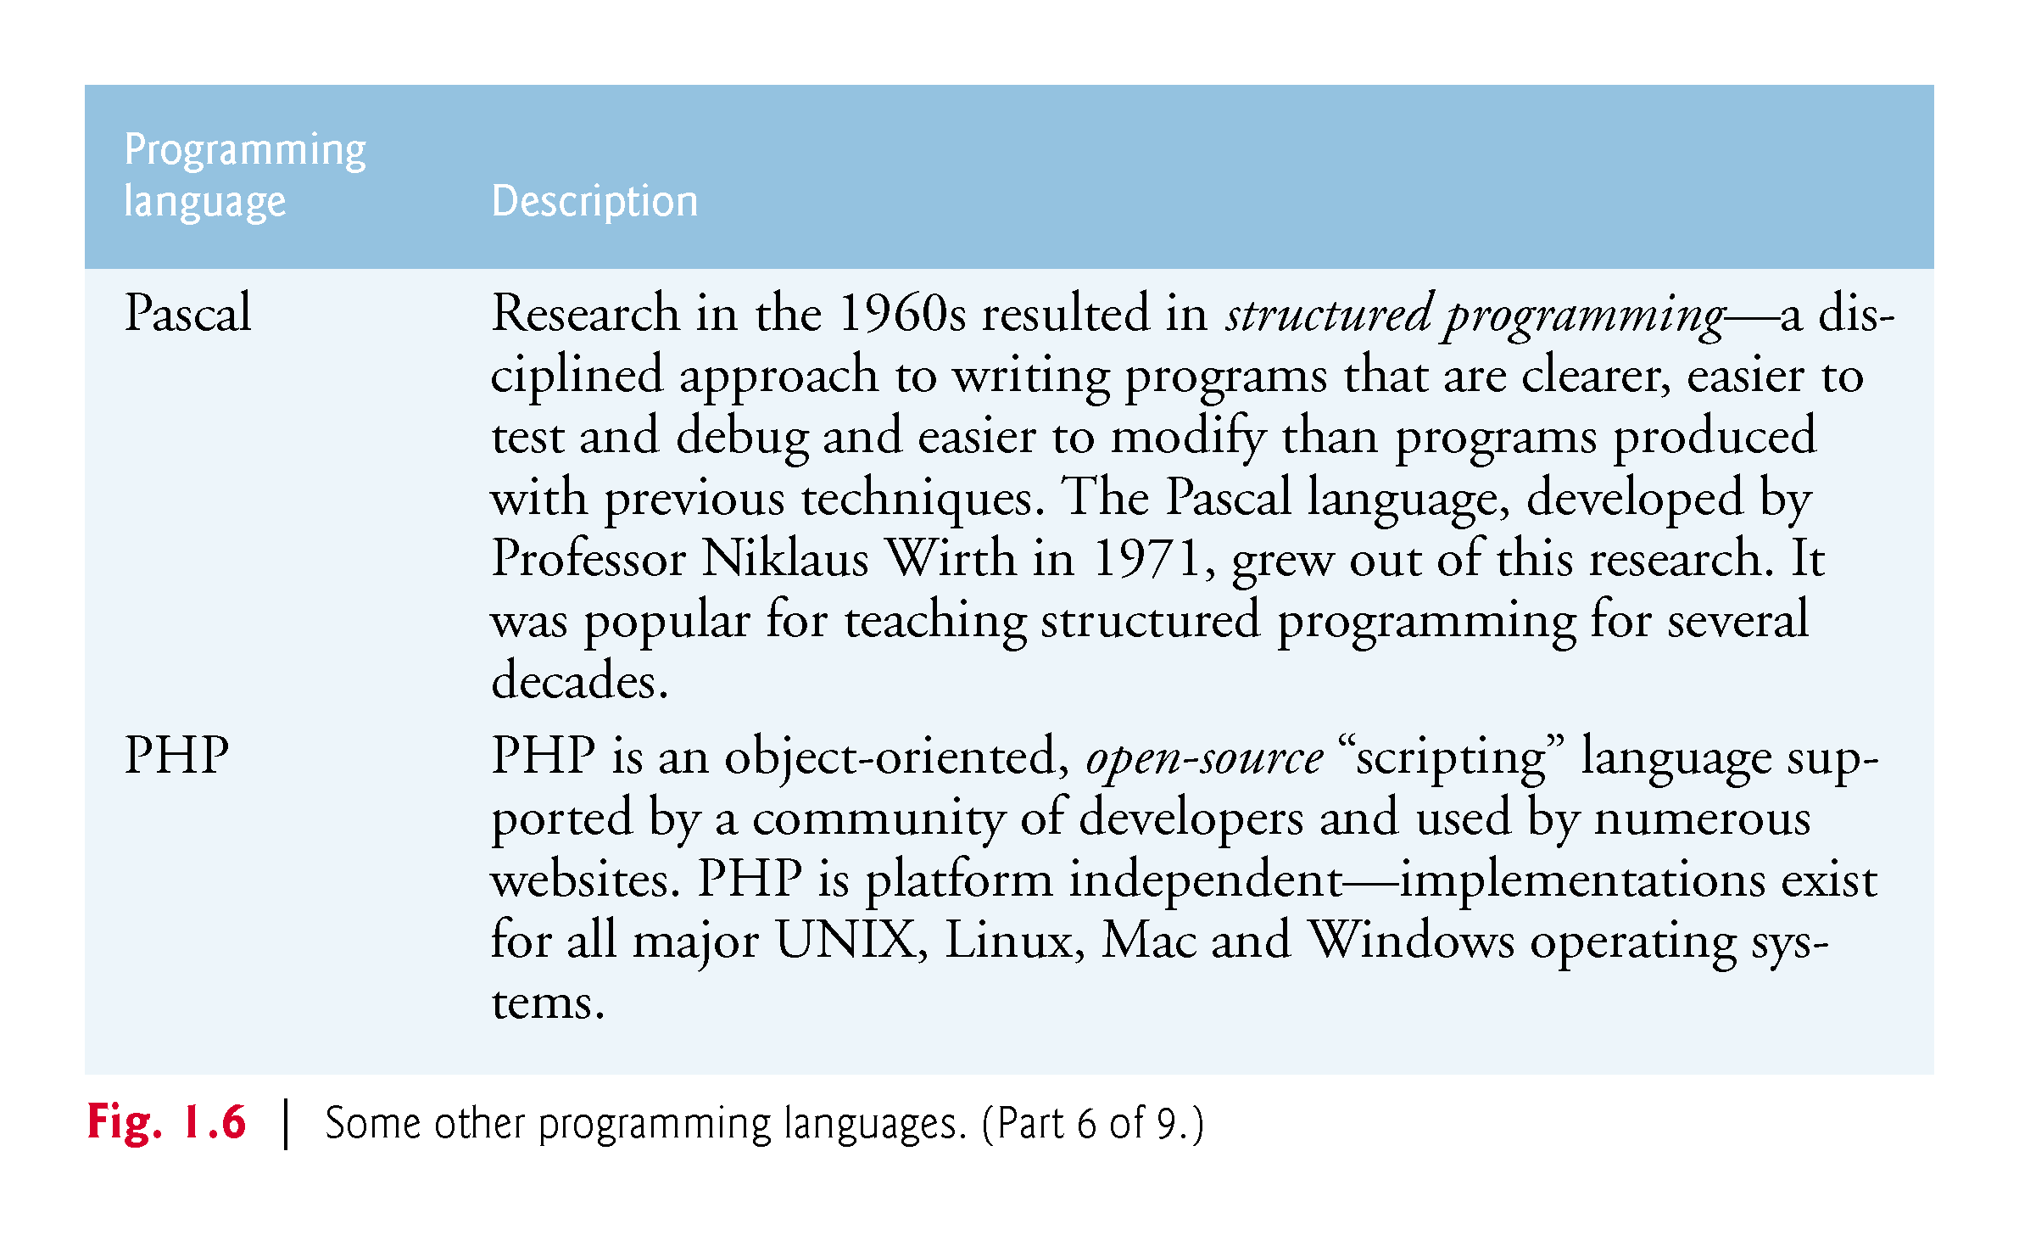

Slide 83
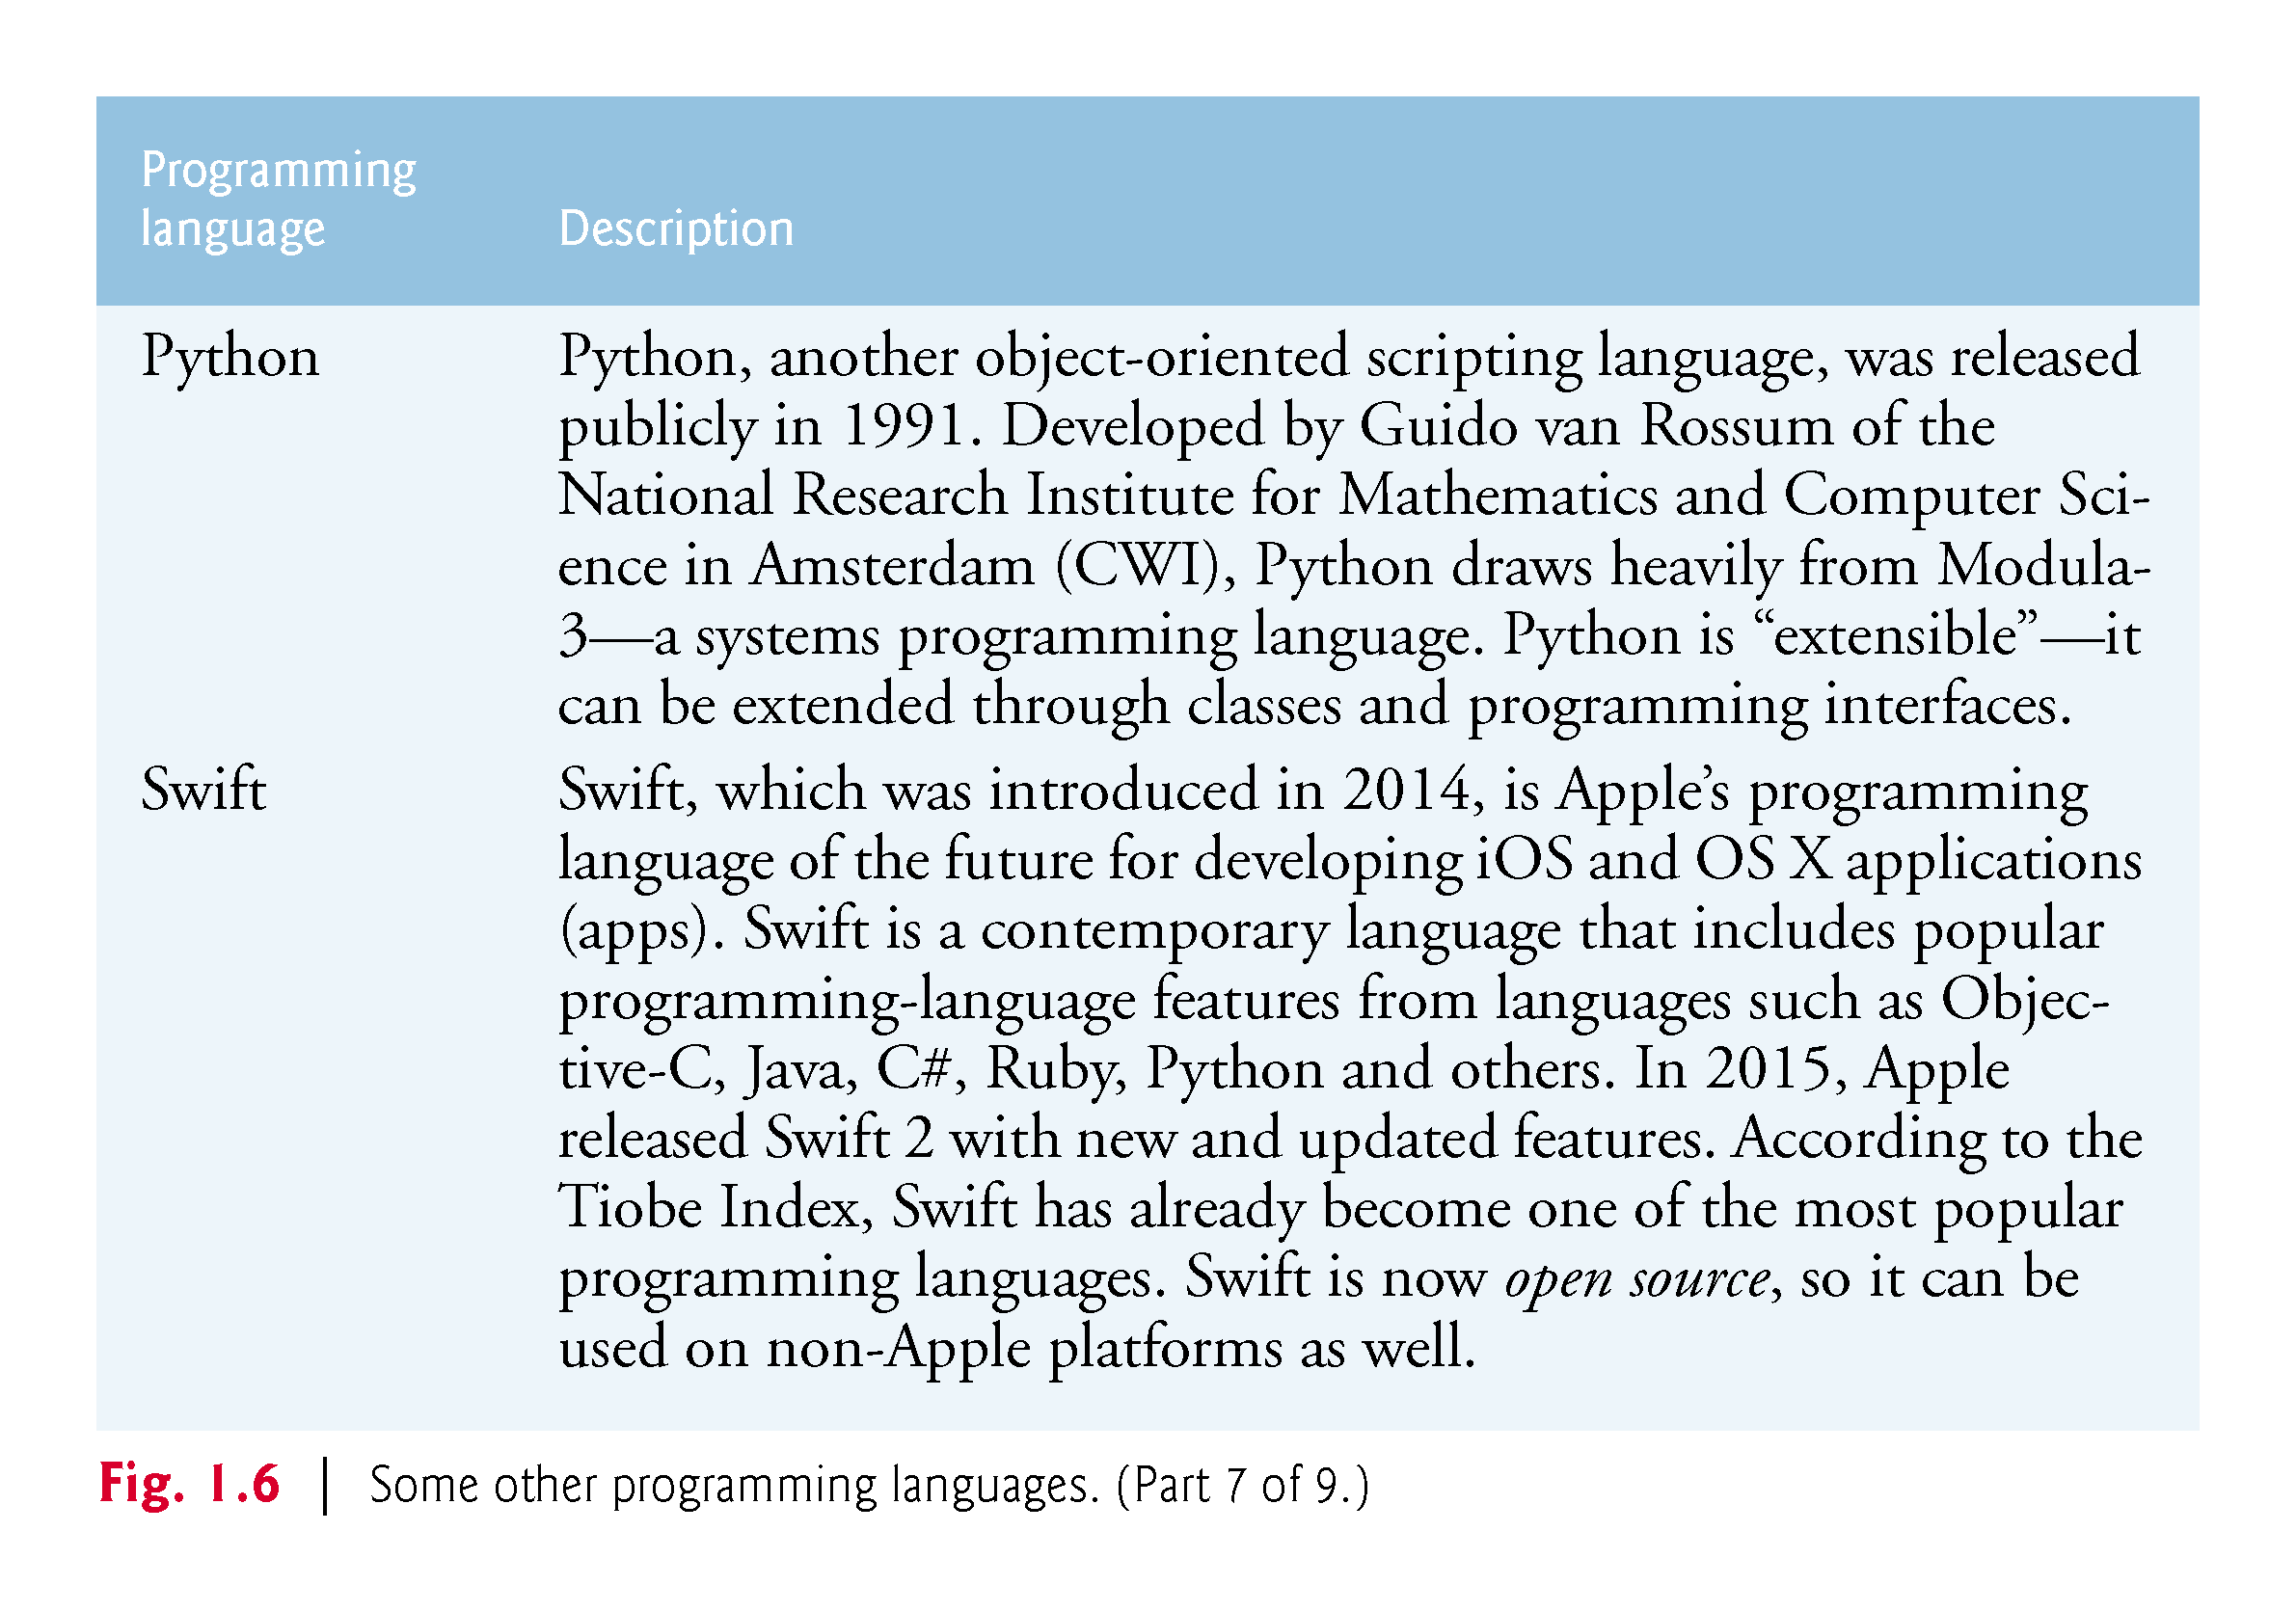

Slide 84
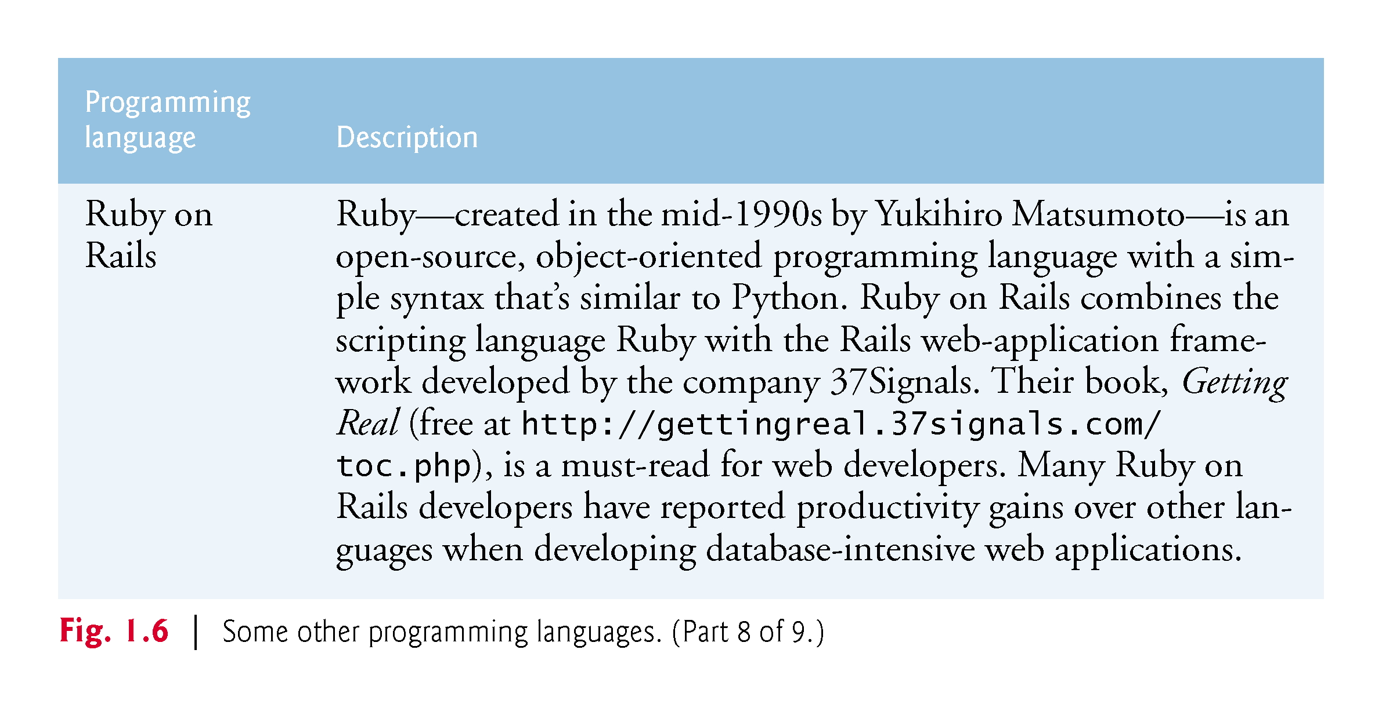

Slide 85
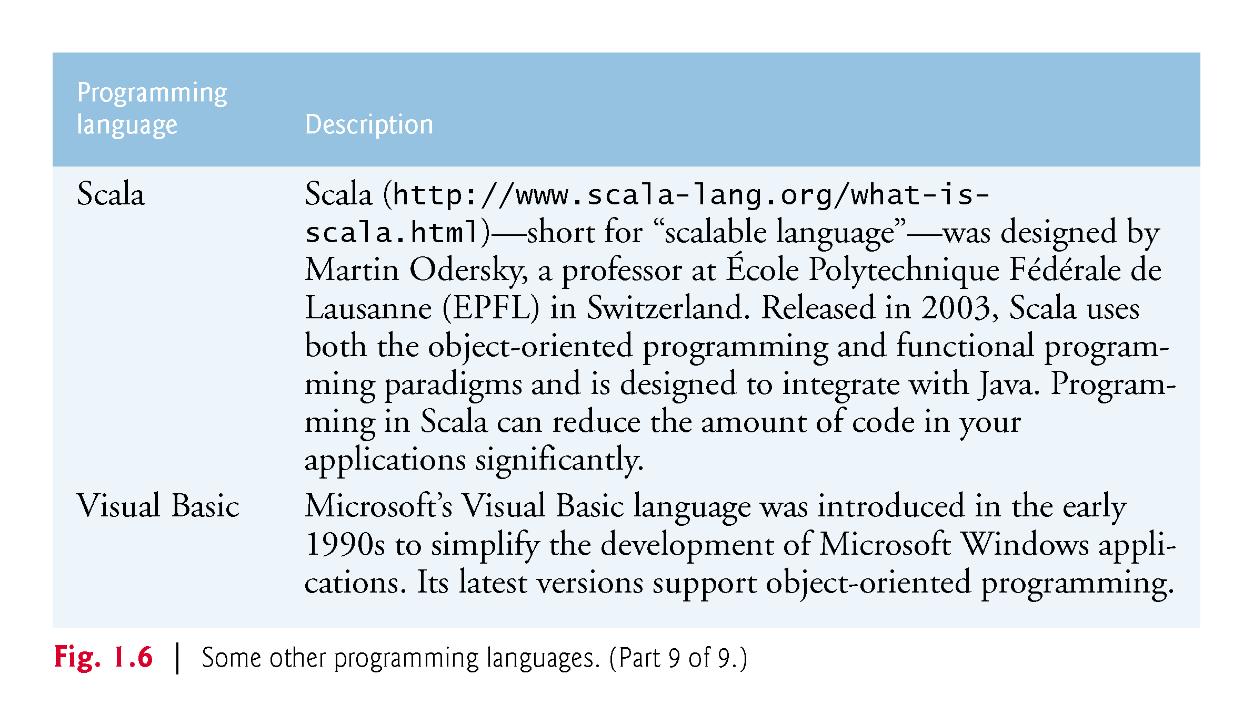

Slide 86
1.9 Microsoft’s .NET
In 2000, Microsoft announced its .NET initiative (www.microsoft.com/net), a broad vision for using the Internet and the web in the development, engineering, distribution and use of software.
Rather than forcing you to use a single programming language, .NET permits you to create apps in any .NET-compatible language (such as C#, Visual Basic, Visual C++ and others).

Slide 87
1.9.1 .NET Framework
The .NET Framework Class Library provides many capabilities that you’ll use to build substantial C# apps quickly and easily.
It contains thousands of valuable prebuilt classes that have been tested and tuned to maximize performance.
You should re-use the .NET Framework classes whenever possible to speed up the software-development process, while enhancing the quality and performance of the software you develop.

Slide 88
1.9.2 Common Language Runtime
The Common Language Runtime (CLR) executes .NET programs and provides functionality to make them easier to develop and debug.
The CLR is a virtual machine (VM)—software that manages the execution of programs and hides from them the underlying operating system and hardware.
The source code for programs that are executed and managed by the CLR is called managed code.

Slide 89
1.9.2 Common Language Runtime
The CLR provides various services to managed code
integrating software components written in different .NET languages,
error handling between such components,
enhanced security,
automatic memory management and more.
Unmanaged-code programs do not have access to the CLR’s services, which makes unmanaged code more difficult to write.

Slide 90
1.9.2 Common Language Runtime
Managed code is compiled into machine-specific instructions in the following steps:
First, the code is compiled into Microsoft Intermediate Language (MSIL).
Code converted into MSIL from other languages and sources can be woven together by the CLR—this allows programmers to work in their preferred .NET programming language.
The MSIL for an app’s components is placed into the app’s executable file—the file that causes the computer to perform the app’s tasks.
When the app executes, another compiler (known as the just-in-time compiler or JIT compiler) in the CLR translates the MSIL in the executable file into machine-language code (for a particular platform).
The machine-language code executes on that platform.

Slide 91
1.9.3 Platform Independence
If the .NET Framework exists and is installed for a platform, that platform can run any .NET program.
The ability of a program to run without modification across multiple platforms is known as platform independence.
Code written once can be used on another type of computer without modification, saving time and money.

Slide 92
1.9.4 Language Interoperabilit7
The .NET Framework provides a high level of language interoperability.
Because software components written in different .NET languages (such as C# and Visual Basic) are all compiled into MSIL, the components can be combined to create a single unified program.
Thus, MSIL allows the .NET Framework to be language independent.

Slide 93
1.9.4 Language Interoperabilit
The .NET Framework Class Library can be used by any .NET language. The latest release of .NET includes .NET 4.6 and .NET Core:
NET 4.6 introduces many improvements and new features, including ASP.NET 5 for web-based applications, improved support for today’s high-resolution 4K screens and more.
.NET Core is the cross-platform subset of .NET for Windows, Linux, OS X and FreeBSD.

Slide 94
1.10 Microsoft’s Windows Operating System
Microsoft’s Windows is the most widely personal-computer, desktop operating system worldwide.
Operating systems are software systems that make using computers more convenient for users, developers and system administrators.
They provide services that allow each app to execute safely, efficiently and concurrently (i.e., in parallel) with other apps.
Other popular desktop operating systems include Mac OS X and Linux.
Figure 1.7 presents the evolution of the Windows operating system.

Slide 95
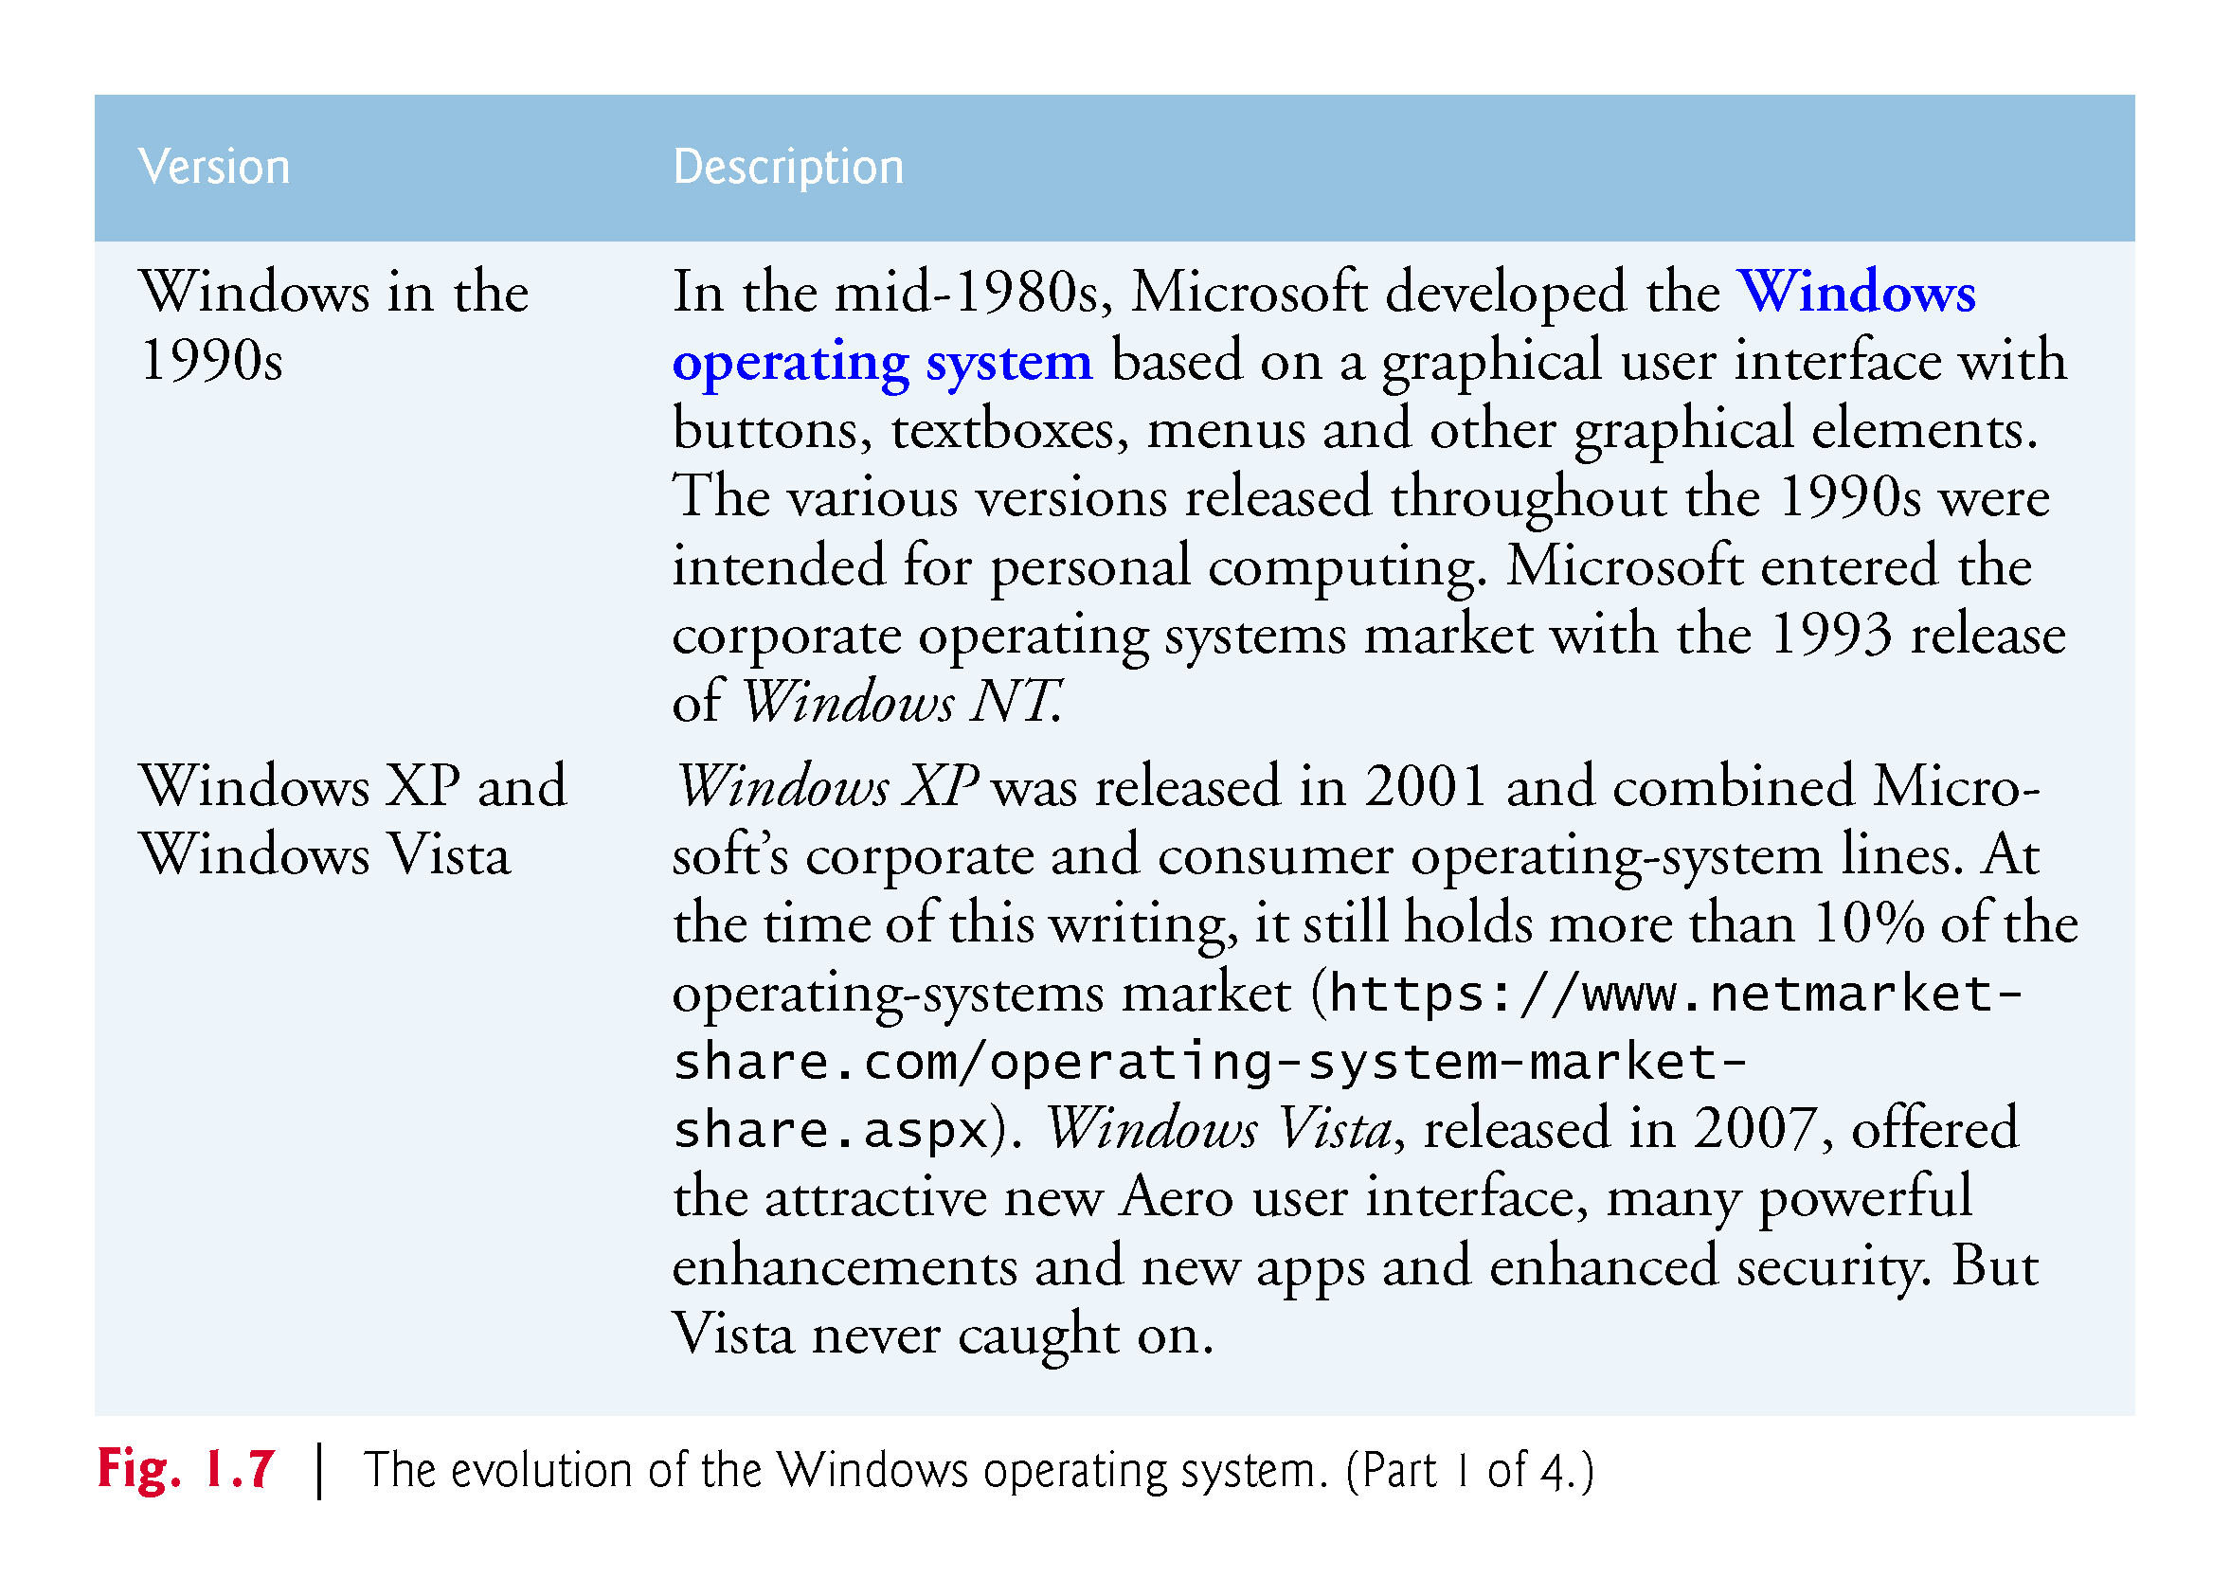

Slide 96
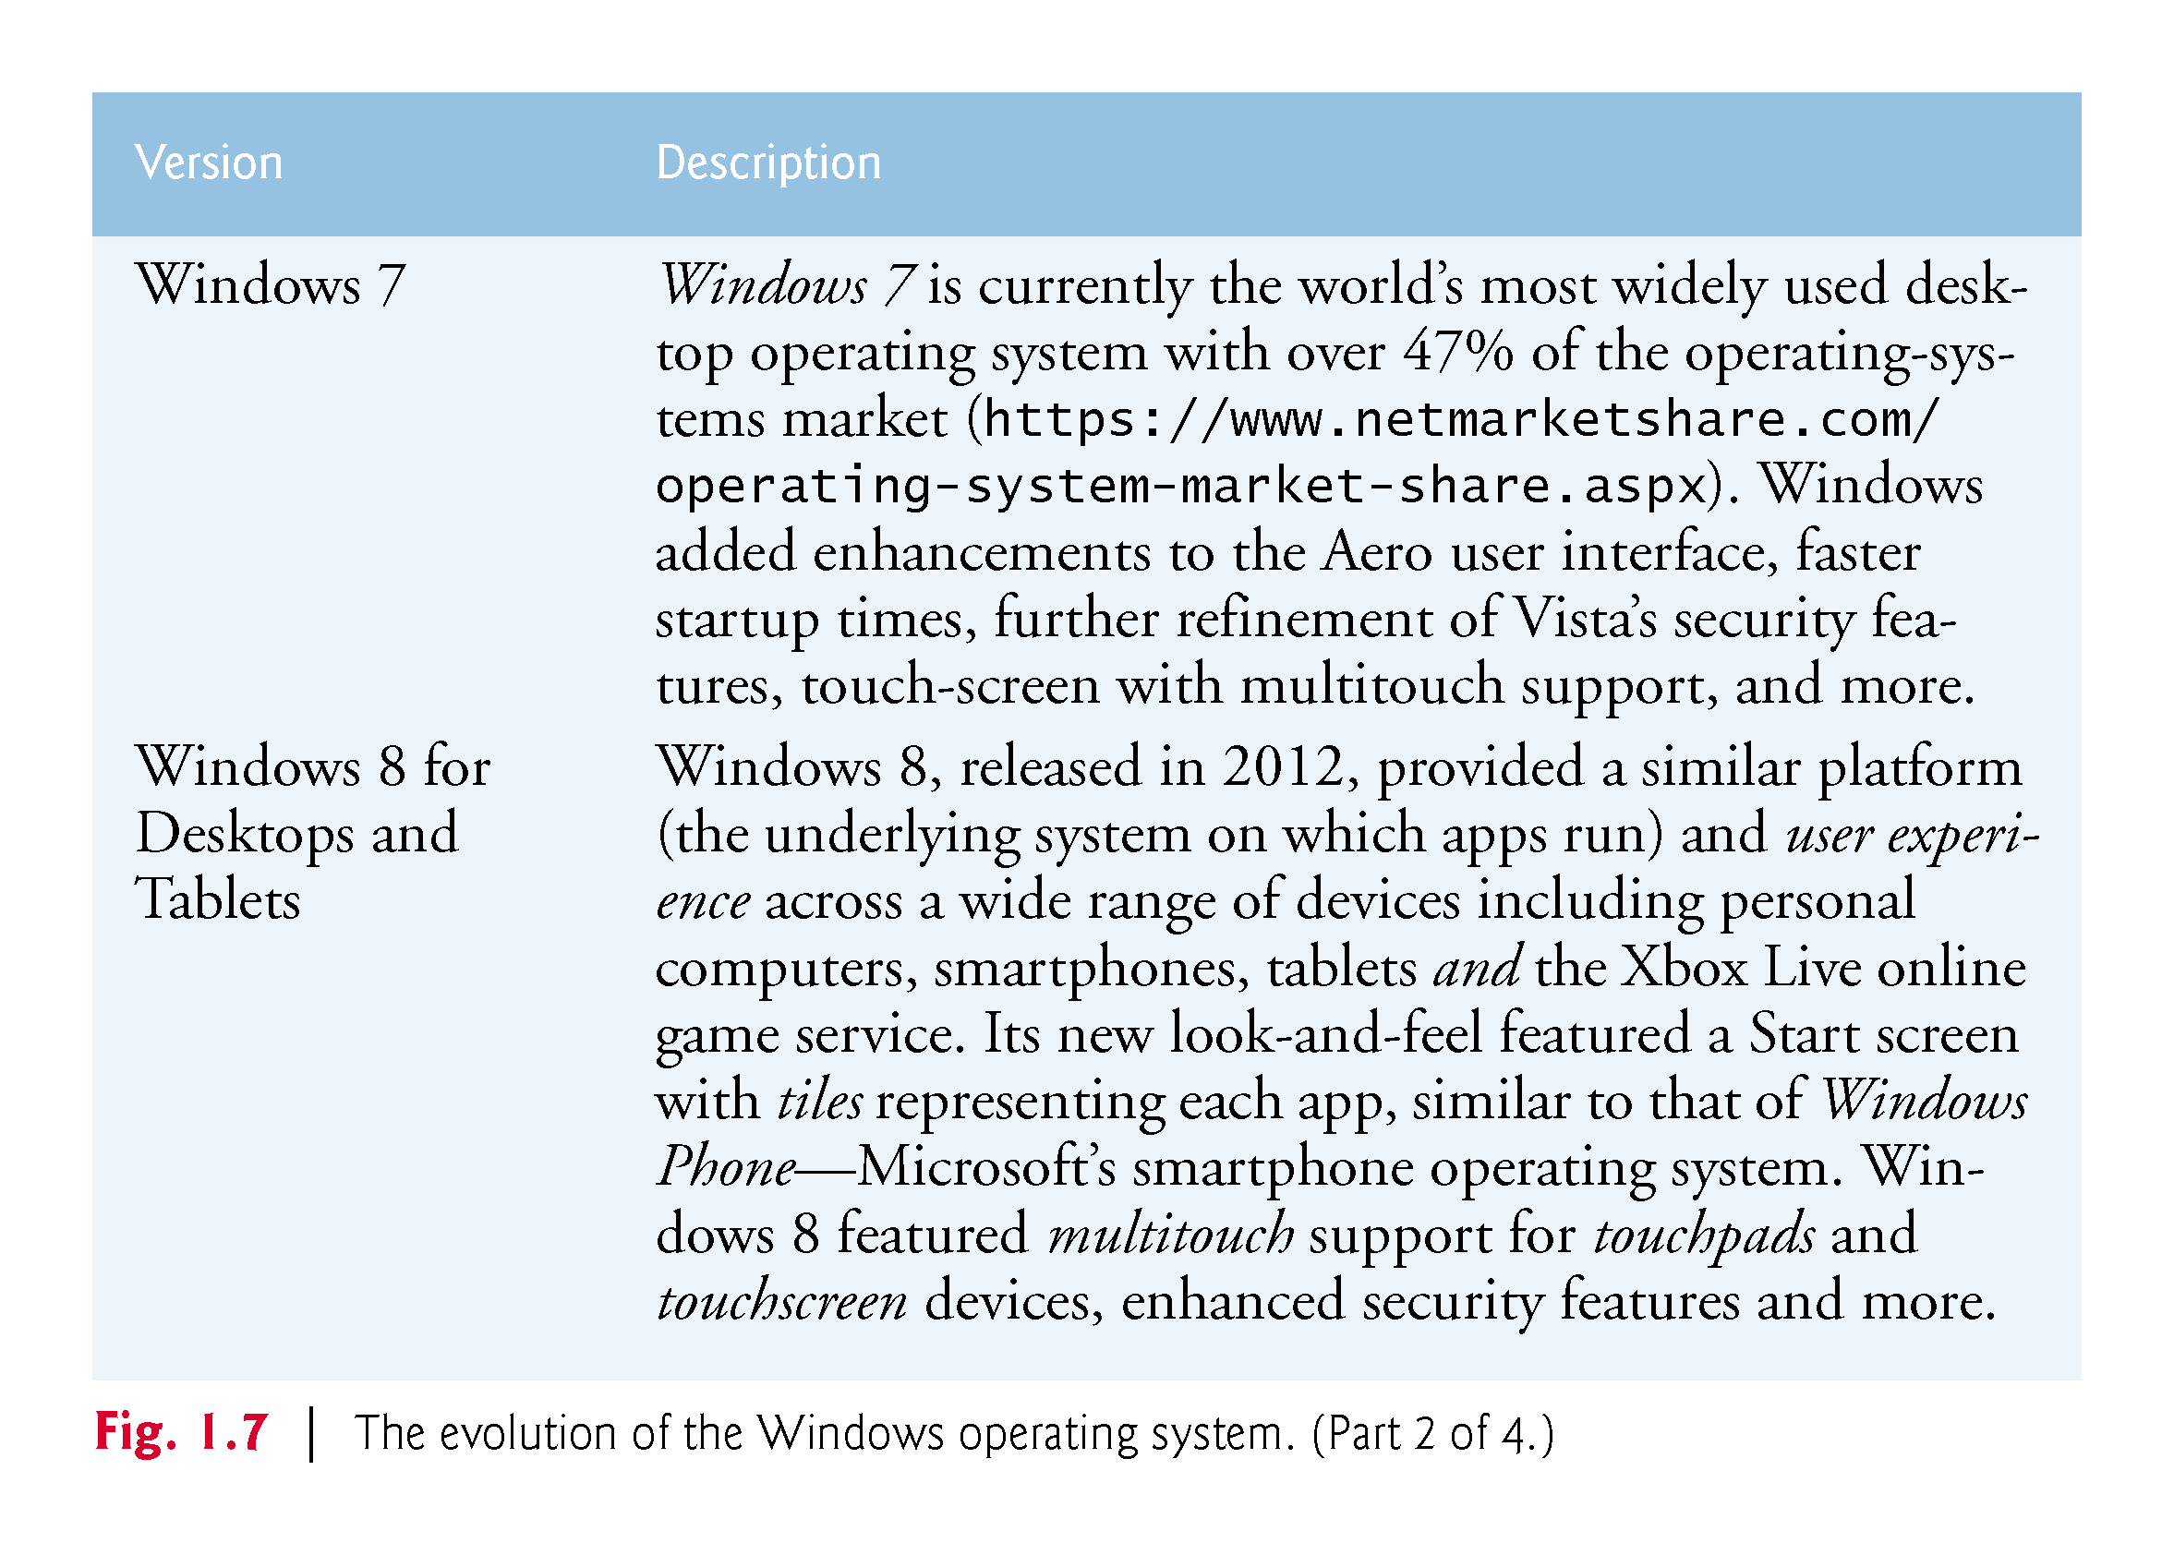

Slide 97
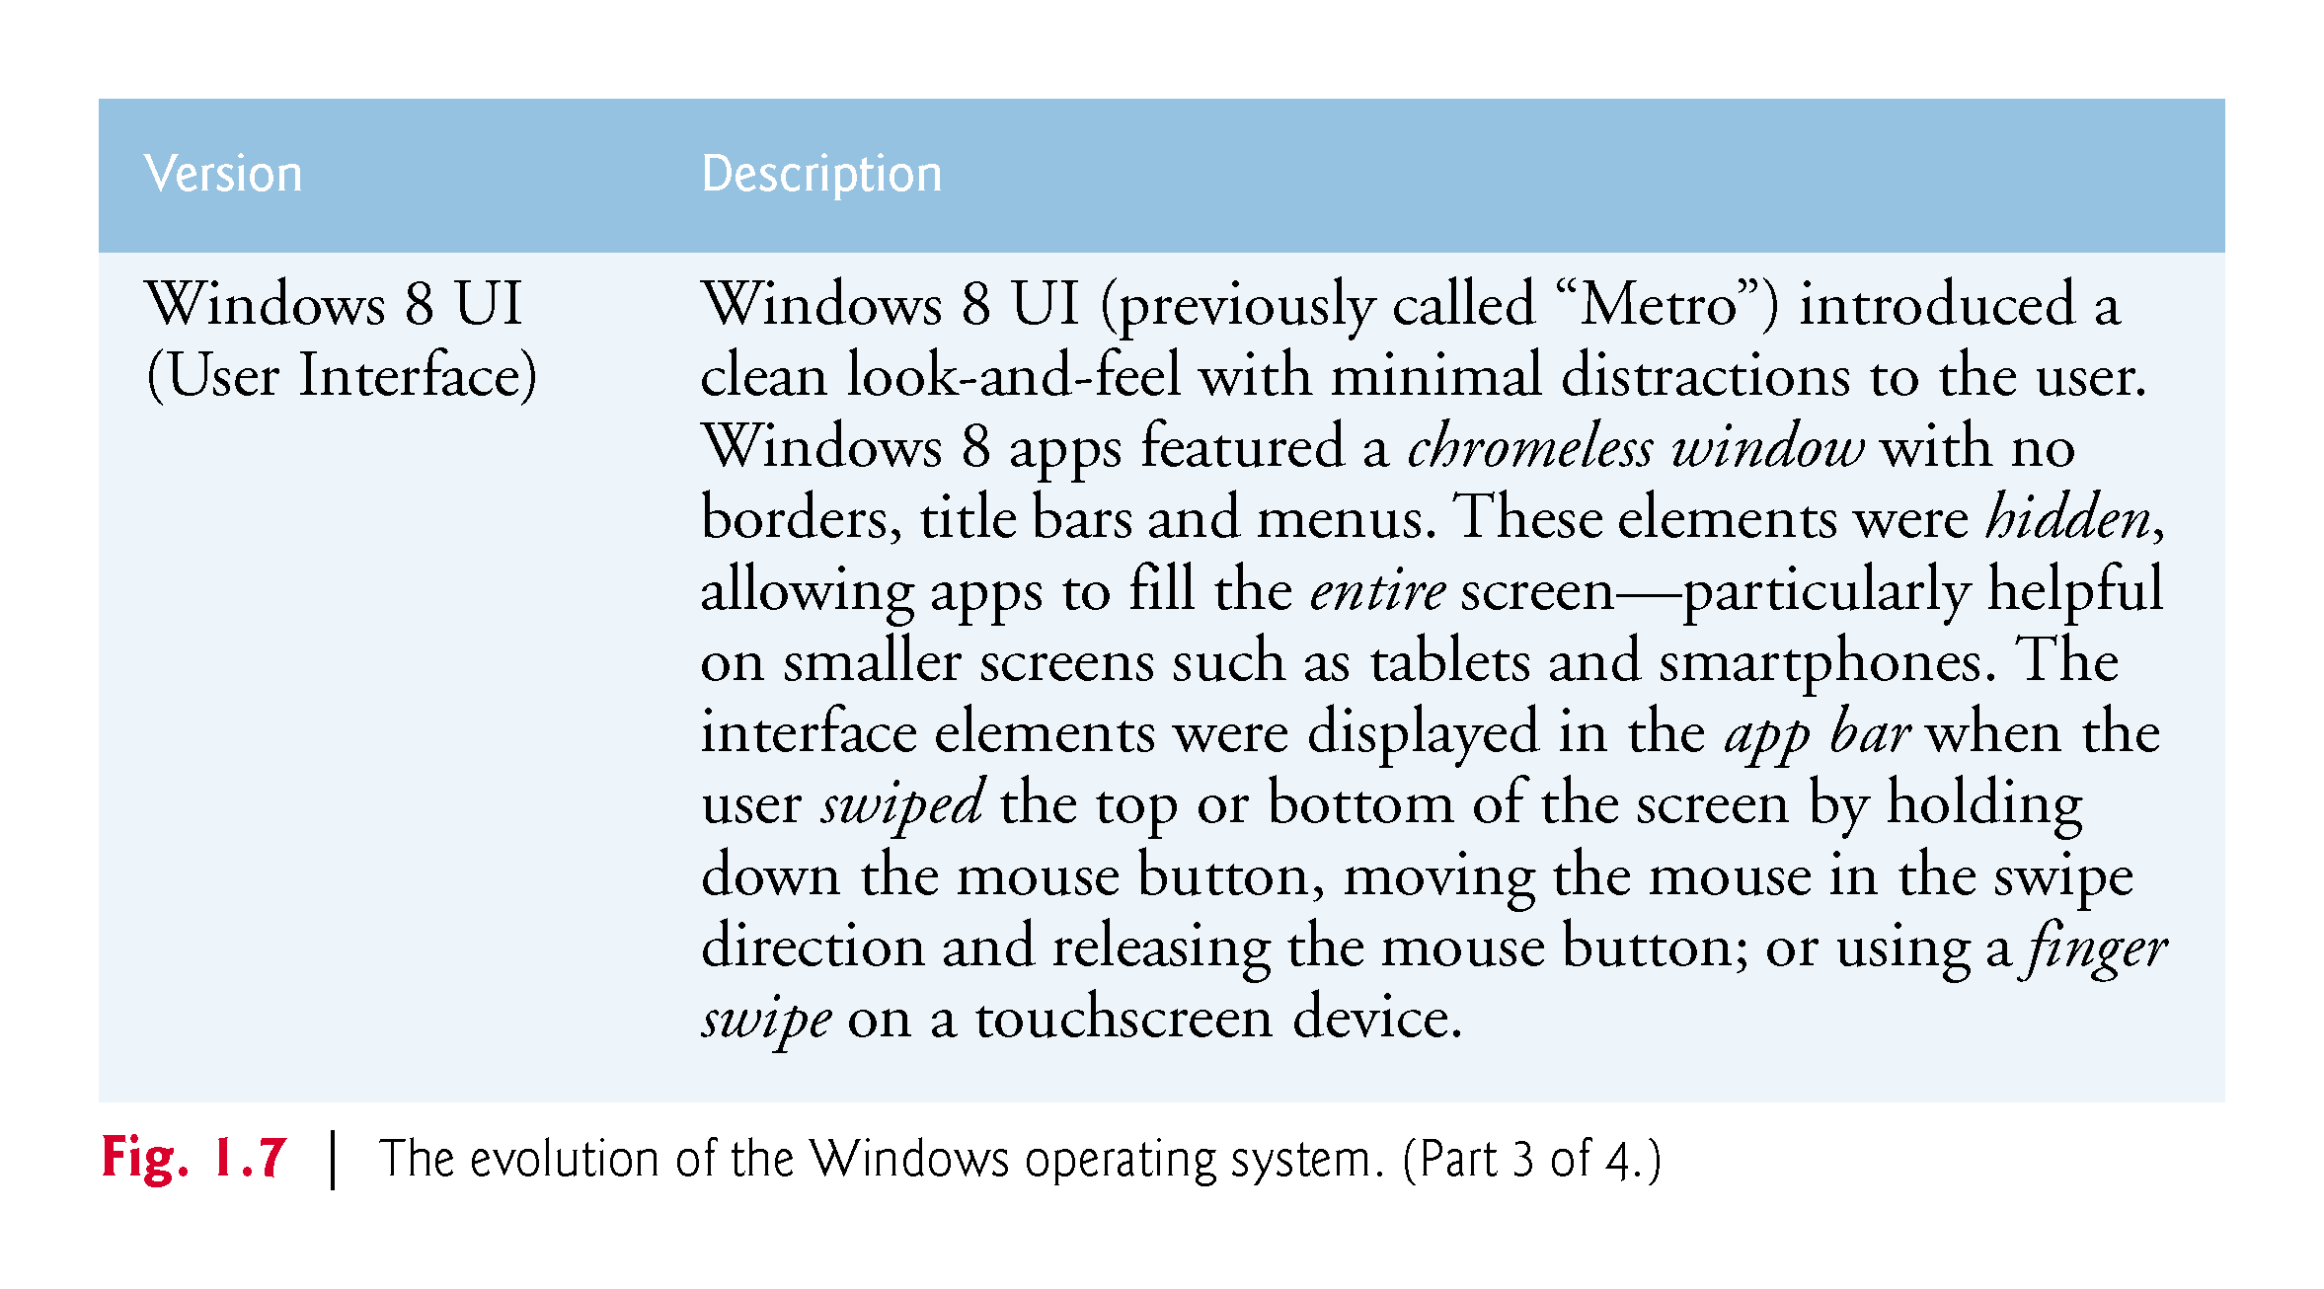

Slide 98
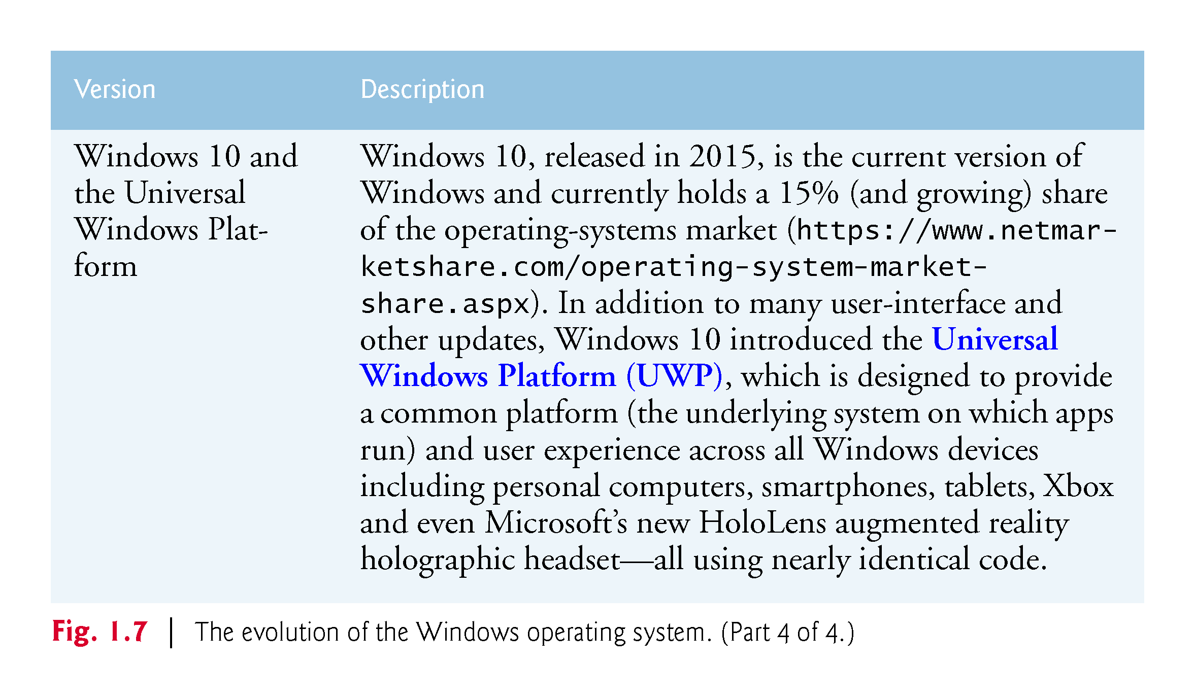

Slide 99
1.10 Microsoft’s Windows Operating System
Windows Store
You can sell apps or offer them for free in the Windows Store. See the App Developer Agreement for more information:
https://msdn.microsoft.com/en-us/library/windows/apps/hh694058.aspx
Several business models for monetizing your app:
Charge full price for your app before download, with prices starting at $1.49.
Offer a time-limited trial or feature-limited trial that allows users to try the app before purchasing the full version, sell virtual goods (such as additional app features) using in-app purchases and more.
https://msdn.microsoft.com/windows/uwp/monetize/index

Slide 100
1.11 Visual Studio Integrated Development Environment
C# programs can be created using Microsoft’s Visual Studio—a collection of software tools called an Integrated Development Environment (IDE).
The Visual Studio Community edition IDE enables you to write, run, test and debug C# programs quickly and conveniently.
It also supports Microsoft’s Visual Basic, Visual C++ and F# programming languages and more.

Slide 101
1.12 Painter Test-Drive in Visual Studio Community

Slide 102
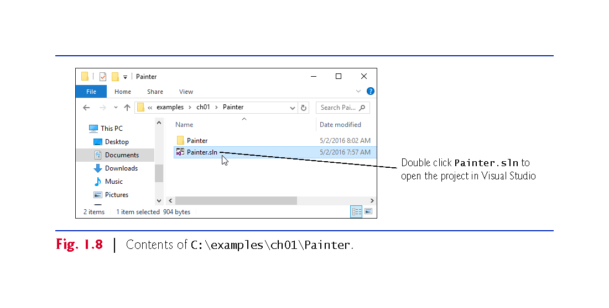

Slide 103
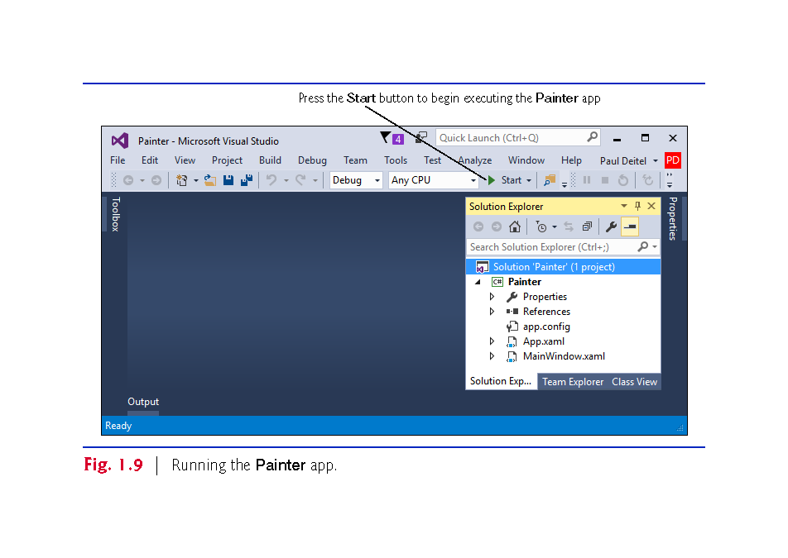

Slide 104
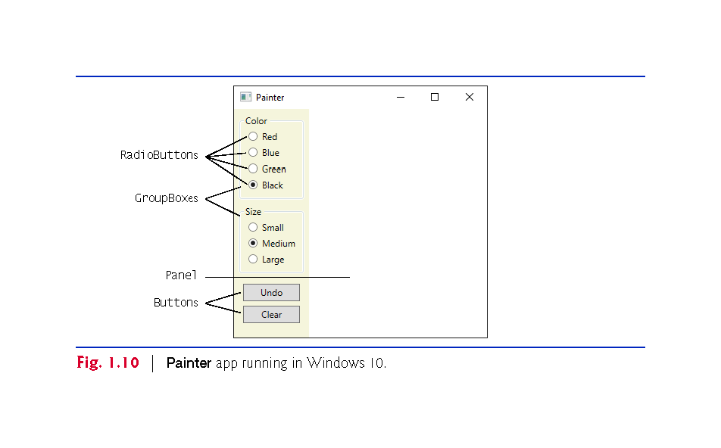

Slide 105
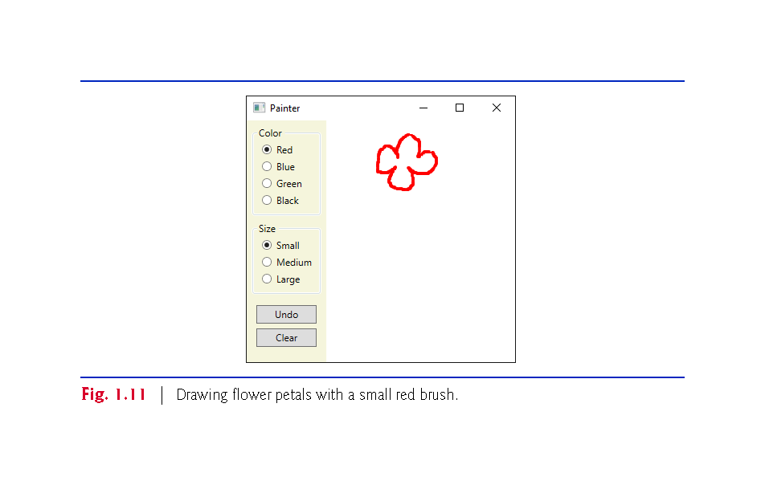

Slide 106
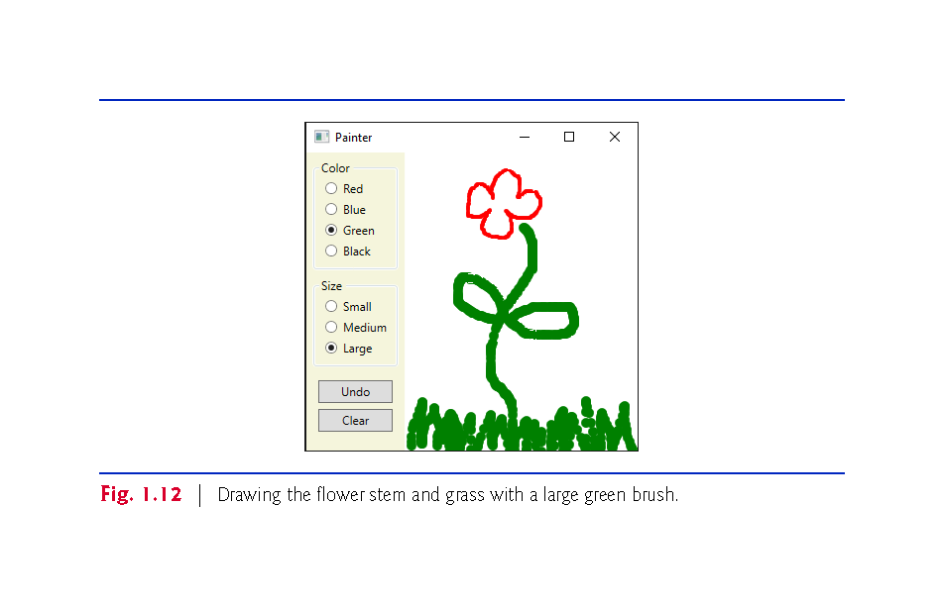

Slide 107
